Slide 1


Large scale high temporal resolution effective connectivity analysis from MEG and the problem of inference
David Gow
Massachusetts General Hospital/Athinuola A. Martinos Center for Biomedical Imaging/Salem State University
gow@helix.mgh.harvard.edu
MIT MEG Workshop, May 6, 2019
Notes:
Gow, David,Ph.D.
Using effective connectivity analyses to build stronger inferences about the functional architecture of cognition
Fifteen years after the close of the “Decade of the Brain”, psycholinguists are still coming to terms with the opportunities and limitations presented by neuroimaging. In this talk I will explore new techniques for analyzing MRI-constrained source space reconstructions of MEG/EEG data to step beyond the typical model testing, and correlational approaches that have been used to make inferences about the pattern of directed causal interactions between localized neural processors. I will introduce GPS, a GUI driven processing stream that applies Kalman-filter enabled Granger causality analysis to high spatiotemporal resolution brain activation data to measure millisecond-by-millisecond patterns of directed interaction between networks consisting of over 30 nodes during task performance. To illustrate the approach, I will present research examining the role of interactive processes in speech perception, and the reorganization of processing accompanying recovery from acute aphasia.

Slide 2
Outline
Using effective connectivity (directional causation) analysis to discover functional architecture
The logic and assumptions underlying Granger causation
Implementing Granger causation with integrity (GPS)

Slide 3

Challenge: When Multiple Factors Influence Judgements
Count the s’s
Gow et al., 2008 NeuroImage
Lexical context influences categorization, but how?

Slide 4
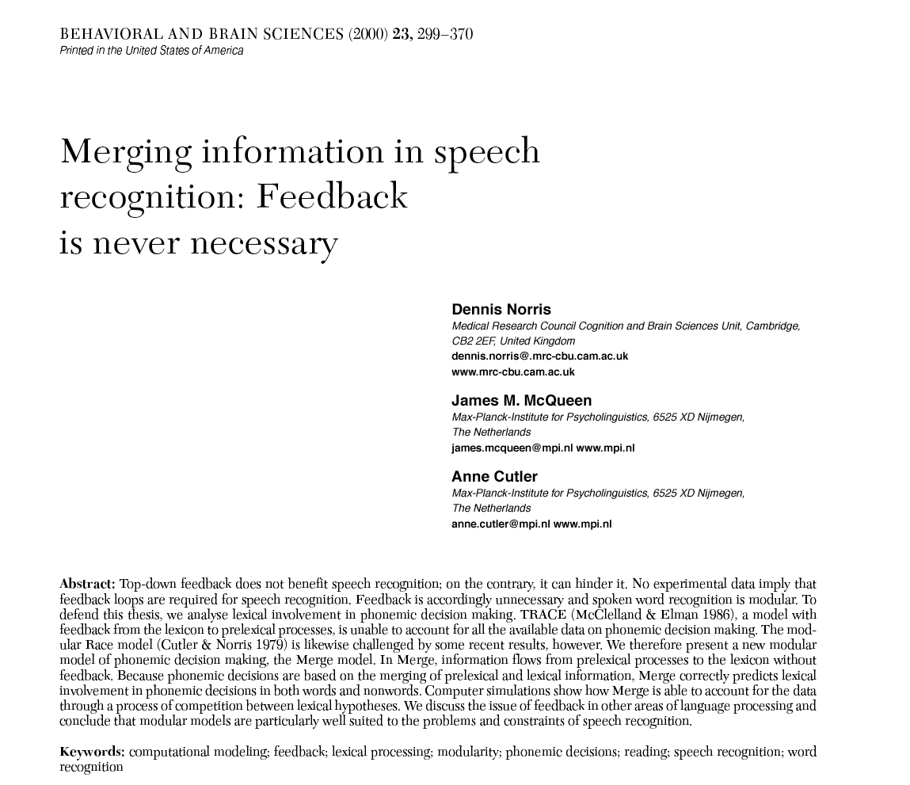

Slide 5
Two Explanations of the Same Results
Decision
Words
Decision
Words
Words
Decision
Words
Sounds
Sounds
Sounds
Sounds
Interactive
Modular
Interactive
Feedforward

Slide 6
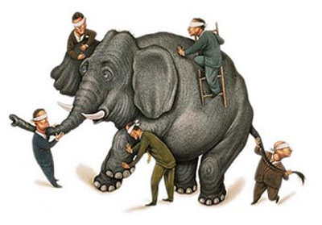
Task effects, decision mechanisms, response biases…
Semantic judgment
Phoneme categorization
Grammaticality
judgment
Lexical decision
Plausability judgment
Notes:
The debate has lasted so long because the methodologies we use only allow us to look at processing stage at a time. This has allowed theorists on both sides of the debate to posit any functional architecture to account for the relationship between all stages.
Traditional Ganong taps phoneme decision
Priming work by Andruski and more recent eyetracking work by McMurray may address the lexical level (although these experiments are not necessarily meant to address Ganong
Ganong-mediated compensaton taps phonetic processing (Elman & McClelland, Pitt & McQueen, Maguson etc.)
All parts addressed independently, but across different paradigms, stimuli, and subjects.

Slide 7
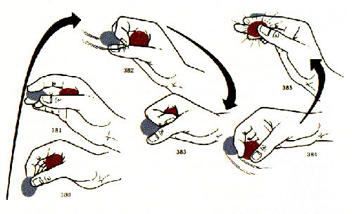
…and the problem of making observations after the interactions have been completed
(The trick has almost always been at least partially completed before the audience sees anything)
Notes:
Turning a silver coin into a brass one

Slide 8
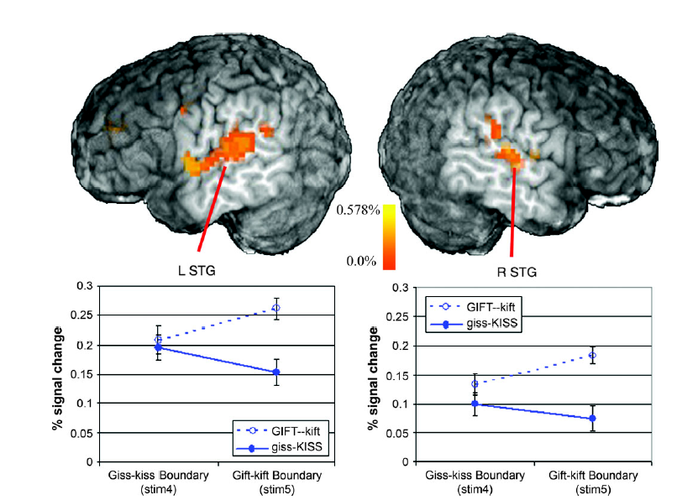
BOLD Imaging: Promise and Challenges
More activation in STG due to feedback, or to initial bottom-up analysis?
Myers & Blumstein, 2007, Cerebral Cortex
Notes:
fMRI in princxiple allows us to look at activation in all parts of the system, which seems like an advance.
Emily Meyers(at Brown) found increased activation of STG (associated with phonetic processing) and the anterior and posterior cingulate (associated with tasks involving explicit decision making)
Implication: The Ganong effect is perceptual
Related: Joe Toscano published a paper in Psychological Science last week showing prior conrext (assocoiatiuve priming MARCH-band) reduced amplitude of N1 component for onst of the primed word in the 75 msce-125 msec window -

Slide 9
Using effective connectivity analyses to discover functional architecture
(this is not news to most of you)
Notes:
Many of you have used this approach, perhaps looking at phase coherence or power (functional connectivity approaches with effective connectivity) to look for functional architecture underlying visual processing or attention

Slide 10
Identify key components of processing models
Words
Decision
Decision
Words
Sounds
Sounds
Interactive
Feedforward
Notes:
Graduated in 1909 at age 14, went on to PhD in math at Harvard, career at MIT
Father of cybernetics

Slide 11
Localize components based on empirical literature
Words
Decision
Decision
Words
pSTG
pSTG
Interactive
Feedforward
Notes:
Speech sound processing in pSTG based on fMRI, iEEG work by Eddy Chang etc.

Slide 12
Localize components based on empirical literature
SMG/pMTG
Decision
Decision
SMG/pMTG
pSTG
pSTG
Interactive
Feedforward
Notes:
Wordform representation in pMTG and SMG (Hickok and Poeppel’s dual stream model, Gow’s dual lexicon model)

Slide 13
Localize components based on empirical literature
SMG/pMTG
Cingulate/vmPFC
SMG/pMTG
Cingulate/vmPFC
pSTG
pSTG
Interactive
Feedforward
Notes:
Animal electrophysiological work…..

Slide 14
Determine Pattern of Effective Connectivity
SMG/pMTG
Cingulate/vmPFC
SMG/pMTG
Cingulate/vmPFC
pSTG
pSTG
Interactive
Feedforward
Falsifiable Predictions
Notes:
Speech sound processing in pSTG based on fMRI, iEEG work by Eddy Chang etc.

Slide 15
Granger Causation:
How to determine which way those arrows point (effective connectivity)
Notes:
Graduated in 1909 at age 14, went on to PhD in math at Harvard, career at MIT
Precedence: Not enough, as in the post hoc ergo propter hoc fallacy (after therefore because), my wife fell in love with me after my hair fell out, but the baldness may not have been what caused it
Prediction: If you want to know causes that dent in your car door, pay attention to the shopping cart rolling across the parking lot

Slide 16
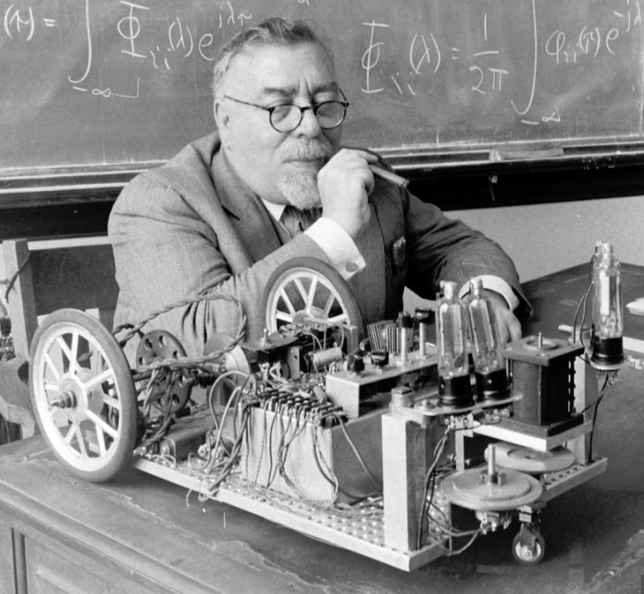
Two intuitions about cause and effect
Causes precede their effects
Norbert Wiener
Notes:
Graduated in 1909 at age 14, went on to PhD in math at Harvard, career at MIT
Precedence: Not enough, as in the post hoc ergo propter hoc fallacy (after therefore because), my wife fell in love with me after my hair fell out, but the baldness may not have been what caused it
Prediction: If you want to know causes that dent in your car door, pay attention to the shopping cart rolling across the parking lot

Slide 17
Precedence (post hoc ergo propter hoc)
Active at time 1
Active at time 2
*neuron, ROI, sensor, physical signal - anything that can be
represented as a time series
Notes:
“After this and so because of this”
The argument at the heart of the anti-vaxxer movement: My child was vaccinated and later developed a spectrum disorder so the vaccine caused it
Anti-vaxxer error: Autism symptoms typically emerge between 12-18 month. CDC guidelines call for a17 vaccinations before the age of 12 months
Mpost children (including most children who develop a spectrum disorder) are vaccinated

Slide 18
Not necessarily!
Active at time 1
Active at time 2
Lag = l
Lag = l+1
Unobserved
place
Notes:
Spurious correlation
Prenatal viral infecrtion (e.g. rubella) appears to be the primary non-genetic cause of ASD. We inoculate infants because they are vulnerable to this infection, and because they pose the potential to spread infection to pregnant women….

Slide 19
Two intuitions about cause and effect
Causes precede their effects
Causes carry unique information to predict effects
Norbert Wiener
Notes:
Graduated in 1909 at age 14, went on to PhD in math at Harvard, career at MIT
Precedence: Not enough, as in the post hoc ergo propter hoc fallacy (after therefore because), my wife fell in love with me after my hair fell out, but the baldness may not have been what caused it
Prediction: If you want to know causes that dent in your car door, pay attention to the shopping cart rolling across the parking lot

Slide 20
Unique prediction
Active at time 1
Active at time 2
x
Lag = l
Lag = l + 1

Slide 21
Significant loss of predictability
Active at time 1
Active at time 2
Lag = l
x
Lag = l+1
Notes:
Playing pool, cue ball hits 2 balls including the eight ball that taps three into a corner pocket – knowing any ball is moving is moving is information, but if you want to know if the 3 ball is going into the corner pocket keep your eye on the eight ball

Slide 22
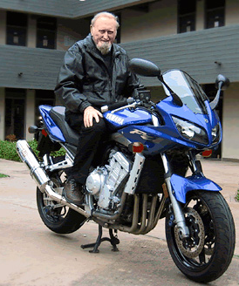
Granger Causation: Implementing Wiener’s definition of causality
Collect timeseries data from everything
Use all of the timeseries data to predict the future of one variable (X). The model will be wrong!
Repeat step 2, but remove one variable (Y) from your predictive model.
Compare the error terms from step 1 and 2
If the error term is bigger in step 3, then we conclude that Y Granger causes X.
Sir Clive Granger
Notes:
Clive W.J. Granger, 2003 Nobel Prize medal in economics

Slide 23
Implementation: Prediction by lagged vector autoregression model (VAR)
1. Make a prediction about a future state using all available data except a potential cause:
2. Make a another prediction about a future state using all available data:
3. Compare error terms (if restricted > unrestricted error we have measurable causation)
Notes:
Simple bivariate model, lacks the fill power of GCA

Slide 24
Critical assumptions/requirements of classical Granger causation
Imaging modality
Sufficient temporal resolution for timeseries analysis, sufficient spatial resolution for functional inference, measure everything
Measure everything (or at least everything that appears to doing something)
Eliminate all redundant signals
Signals must be stationary (at least in Classical Granger)
Keep measurement noise within manageable bounds
Use methods that make strong predictions
ROI selection
Kalman Filter
Notes:
Simple bivariate model, lacks the fill power of GCA

Slide 25
GPS: Implementing Granger’s Assumptions with Integrity

Slide 26
Imaging Considerations
Requirements
Measure everything*
Sufficient temporal resolution for ER timeseries analysis
Sufficient temporal resolution to relate to localization literature
Brain
Brodm.
Area
Column
Layer
Neuron
Synapse
MEG/EEG
Lesion
fMRI
PET
Good Coverage
Poor Coverage
Space
intracranial
MS Second Min Hour Day
Time
Notes:
Simple bivariate model, lacks the fill power of GCA

Slide 27
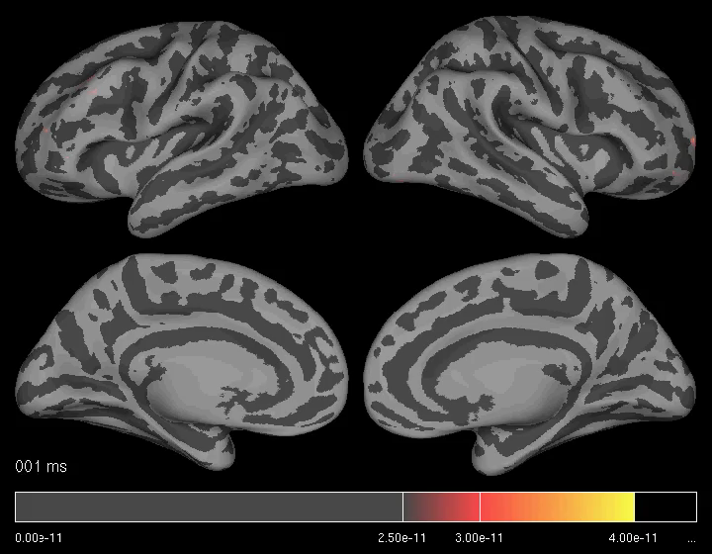
MR-constrained MEG/EEG (MNE)
Notes:
Minimum norm estimate: Minimizes difference between measurement and model (by adjusting diplole orientation and amplitude) measured by the Euclidean norm (square root of the sum of the squared distances from the avt
MS resolution (sampling at 1200 Hz)
Spatial resolution ~ within a Brodmann’s area
Imrpoved method: Wakeman multimodal integration gets spatial localization from fMRI, identifies which MEG vertices best reflect activation at those positions (brain geometry creates systemmatic distortion of MEG signal, crosstalk identifies inverse)

Slide 28
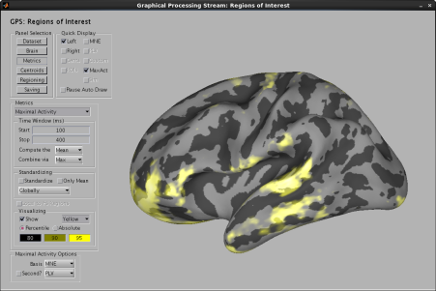
Identifying ROIs: 1. Average activation
Identifying a reasonably comprehensive set of potential ROIs
Notes:
Activat

Slide 29
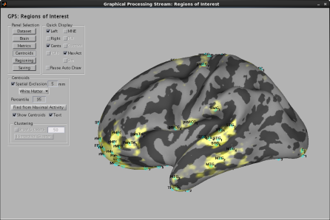
Identifying ROIs: 1. Identify centroids over all cortical surfaces
Identifying a reasonably comprehensive set of potential ROIs
Notes:
Activat

Slide 30
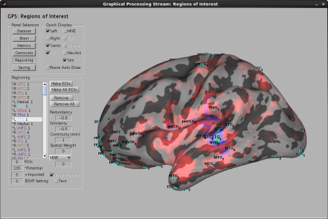
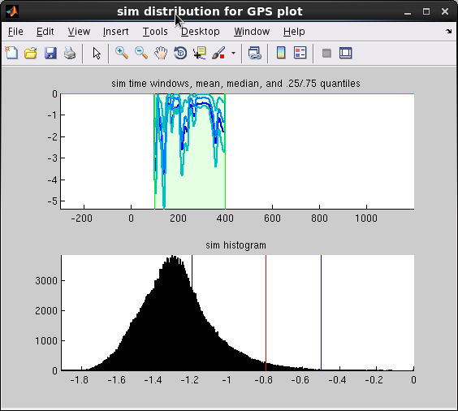
Identifying ROIs: 3. Eliminate redundant ROIs based on timeseries comparison
(non-redundant)
v
Identifying a reasonably comprehensive set of potential ROIs
Notes:
Noramlize activation time series and compare similarity

Slide 31
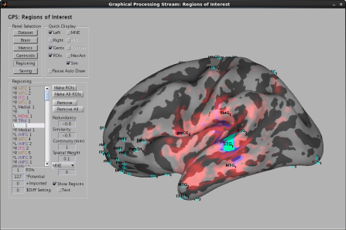
Identifying ROIs: 3. Define ROI around centroid based on timeseries comparison
(non-redundant)
v
Identifying a reasonably comprehensive set of potential ROIs
Notes:
Typically produces 15-30 ROIs based on common parameters for speech perception tasks in first 0-500 ms
Larger than practical for dynamic causal mapping

Slide 32
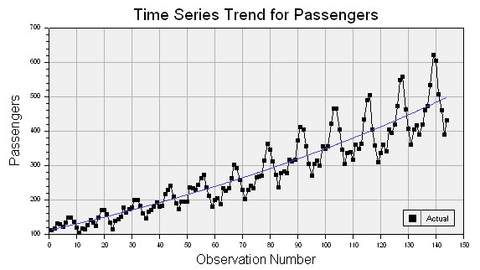
Prediction and the Stationarity Problem
Solutions:
Transform (demean,differ-erence etc.)
Use small moving windows
Solution: Make predictions moment by moment, not over time
Notes:
Stationarity: Does the variance and/or central tendency change over time

Slide 33
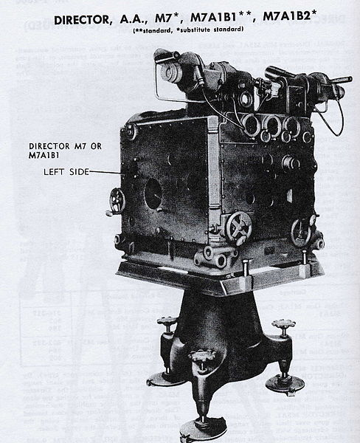
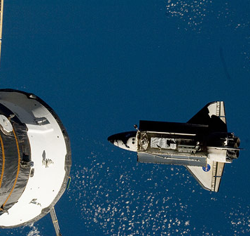
Kalman Filter: Model, Predict, Evaluate, Update
M7 Anti-Aircraft Trajectory Predictor
Shuttle docking
Notes:
Growing fromWieners WWII work on anti-aircraft aiming (managing position, velocity, acceleration, turning to predict where to shoot)
Developed from these independently by ideas by Rudolph Kalman, Thorvald Thiele, Peter Swerling, Ruslan Stratonovych

Slide 34
Kalman Filter: Model, Predict, Evaluate, Update
Initialization:
Random model of how some measures predict another future measure
MEG/EEG measures
Starting model of measurement variability
Correction:
Kalman gain (how much to trust measures)
Update ROI model based on actual (predicted) measure
Update estimate of error covariance
MEG/EEG Measurements
Error terms to calculate
Granger
Prediction:
Estimate (model) of future R0I MEG/EEG activation
Estimate of future error covariance
Notes:
Initialization – start with random model, converges over time (stable by 100 ms)
A lot of matrix algebra to make generate a high dimesnional time varying VAR model
Model uses least squares
Kalman gain – how much do we rely on measures (too much and you model noise, too little and you lose precision, model optimizes desired fit)
Instead of a lot of history, you just need the model’s last best guess to make a prediction

Slide 35
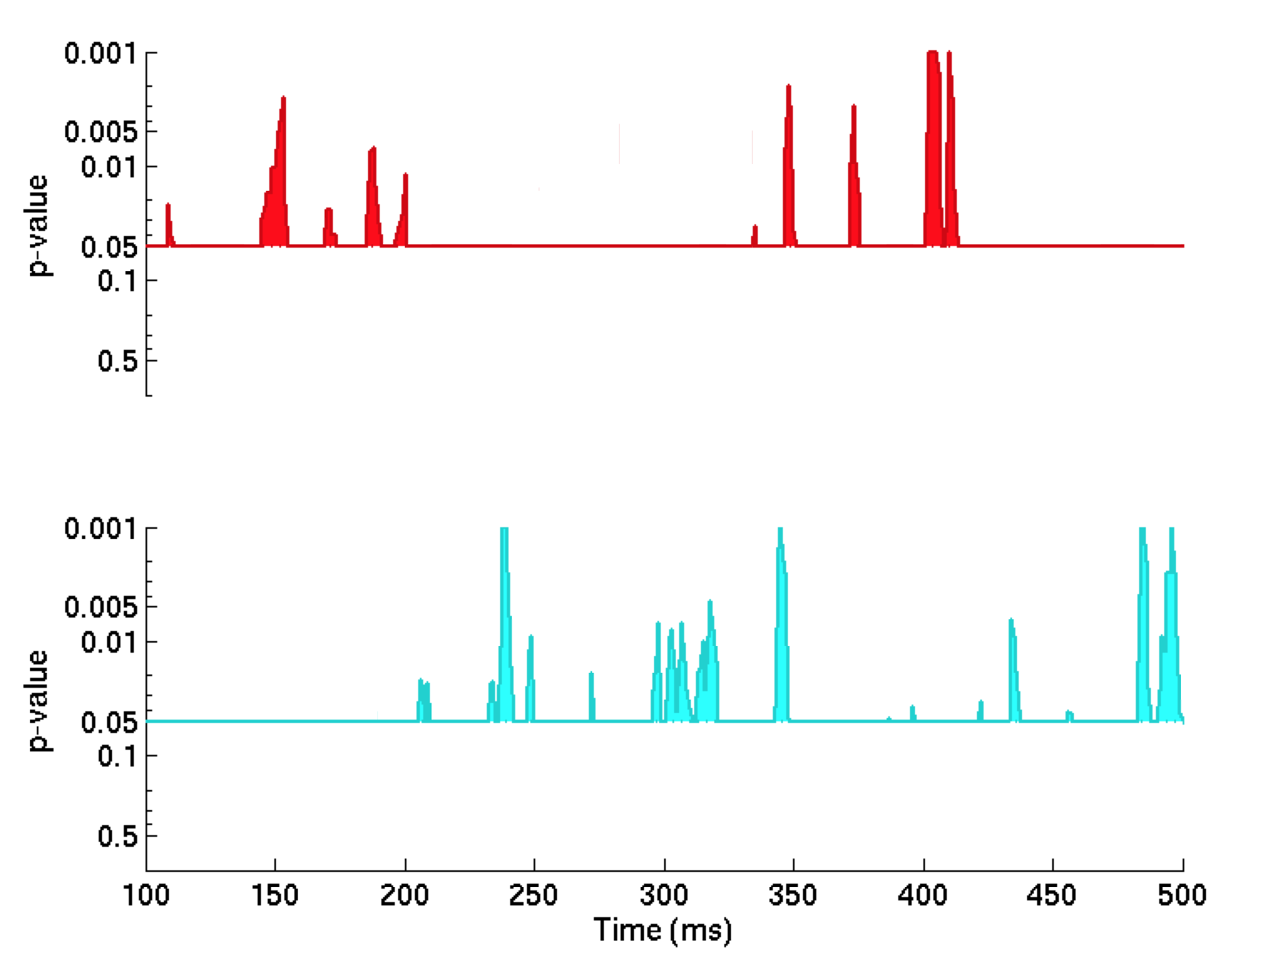
Measuring Granger Causation
Granger causation index (Gci) = log ratio of the standard error of the restricted model to standard error of complete model at each time point
P-value of each measure can be established using a bootstrapping method
Notes:
Initialization – start with random model, converges over time (stable by 100 ms)
A lot of matrix algebra to make generate a high dimesnional time varying VAR model
Model uses least squares
Kalman gain – how much do we rely on measures (too much and you model noise, too little and you lose precision, model optimizes desired fit)
Instead of a lot of history, you just need the model’s last best guess to make a prediction

Slide 36
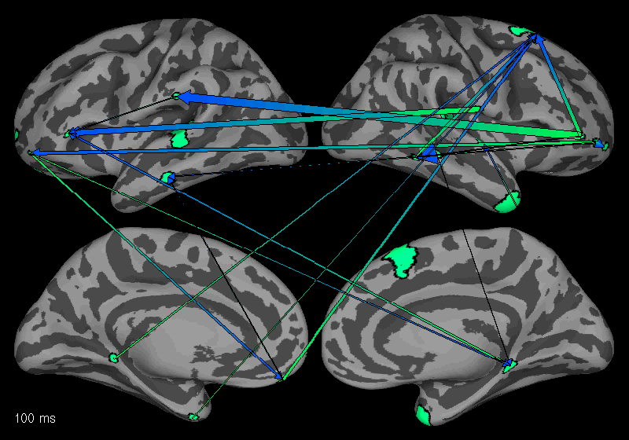
Its Complicated!
Notes:
Initialization – start with random model, converges over time (stable by 100 ms)
A lot of matrix algebra to make generate a high dimesnional time varying VAR model
Model uses least squares
Kalman gain – how much do we rely on measures (too much and you model noise, too little and you lose precision, model optimizes desired fit)
Instead of a lot of history, you just need the model’s last best guess to make a prediction

Slide 37
Data Reduction Through Graph Theory
Hubs of integration or influence
Contribution of ROIs to a focus ROI
Notes:
Initialization – start with random model, converges over time (stable by 100 ms)
A lot of matrix algebra to make generate a high dimesnional time varying VAR model
Model uses least squares
Kalman gain – how much do we rely on measures (too much and you model noise, too little and you lose precision, model optimizes desired fit)
Instead of a lot of history, you just need the model’s last best guess to make a prediction

Slide 38
Afferent/Efferent Relationship between two ROIs
Notes:
Iceberg graph

Slide 39
Comparison between experimental conditions
Notes:
Influences on left STG (greater for phonotactic bias in blue, greater for anti-bias in red, significance derived from binomial test)

Slide 40
GPS: Our processing stream to automate the Granger Analysis of MR-constrained MEG/EEG data

Slide 41
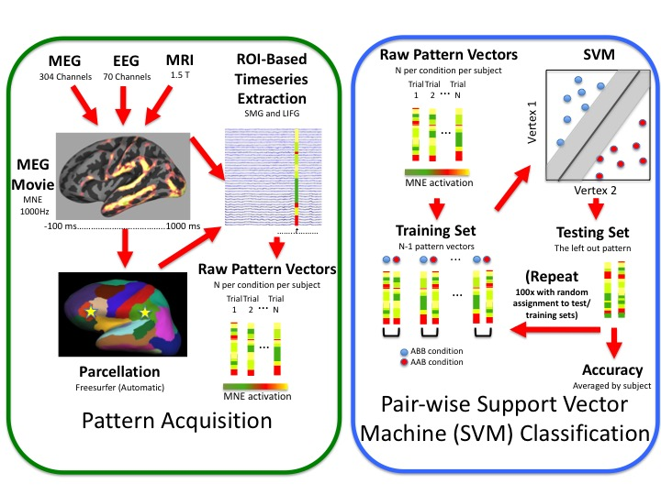
Neural Decoding: Using the same data to probe representation
Notes:
Building an offramp in GPS so we can interrogate individual ROIs to understand what they are representing

Slide 42
Challenges and Opportunities
“Painfully realistic” complexity of results (Spivey, LCN, 2016)
Imaging limitations (coverage, spatial resolution, cost/access)
Redundant signals as latent variables
Interpretation of those arrows (Information flow?
Control processes? Attention? Perceptual learning?)
Notes:
Not surprising that the human brain is complex. Strategy is to focus on falsifiable predictions about narrow parts of the result, and hopefully work outward to embrace full complexity
Modelling will require more sophistication, including implementation of large scale dynamical systems approaches

Slide 43

GPS
GUI-based
Free for download
https://www.martinos.org/software/gps

Slide 44
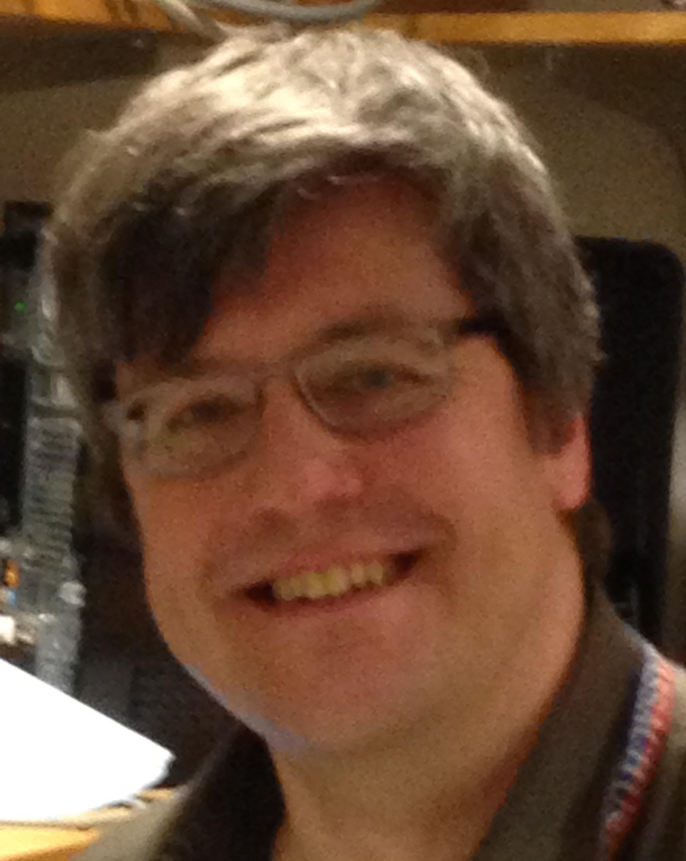
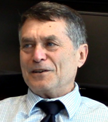
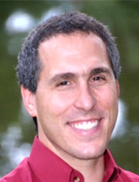
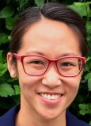
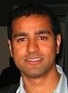
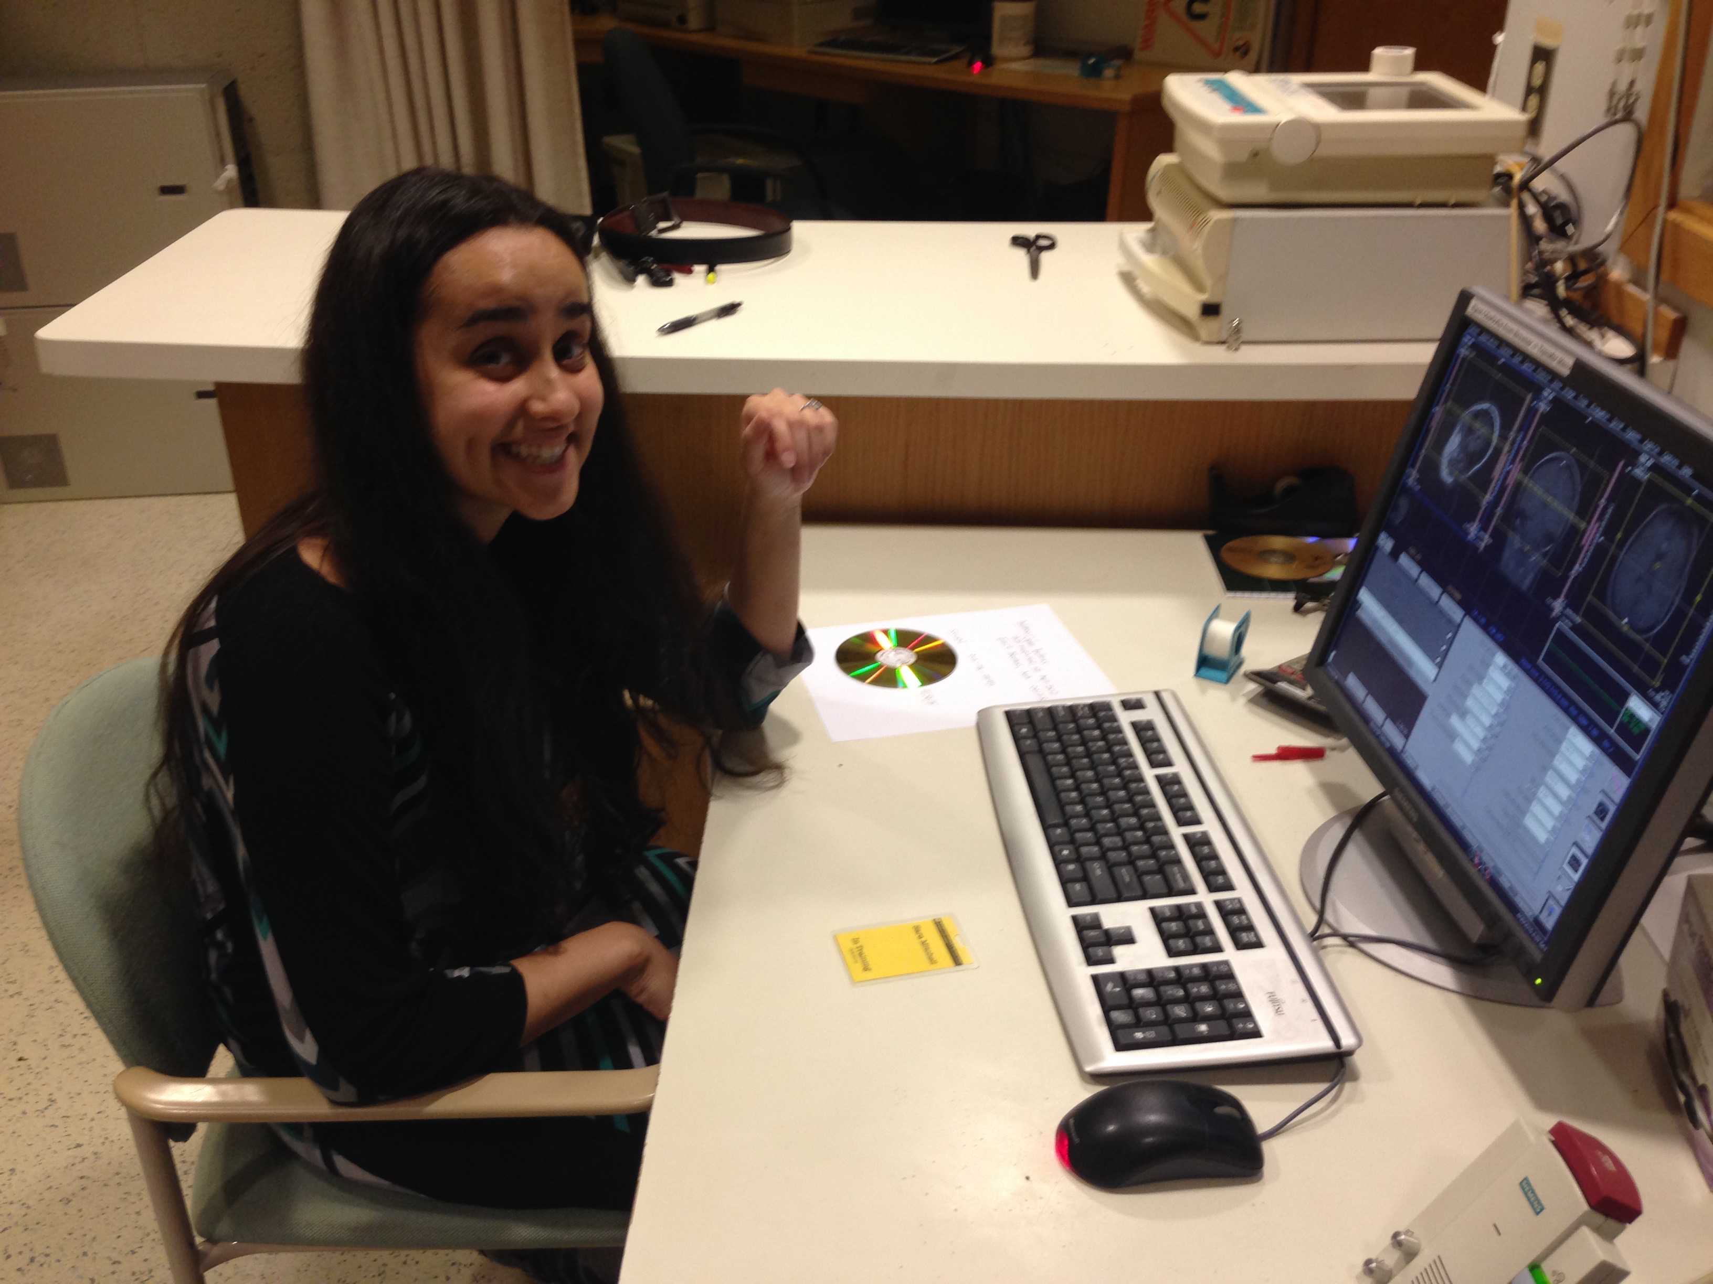
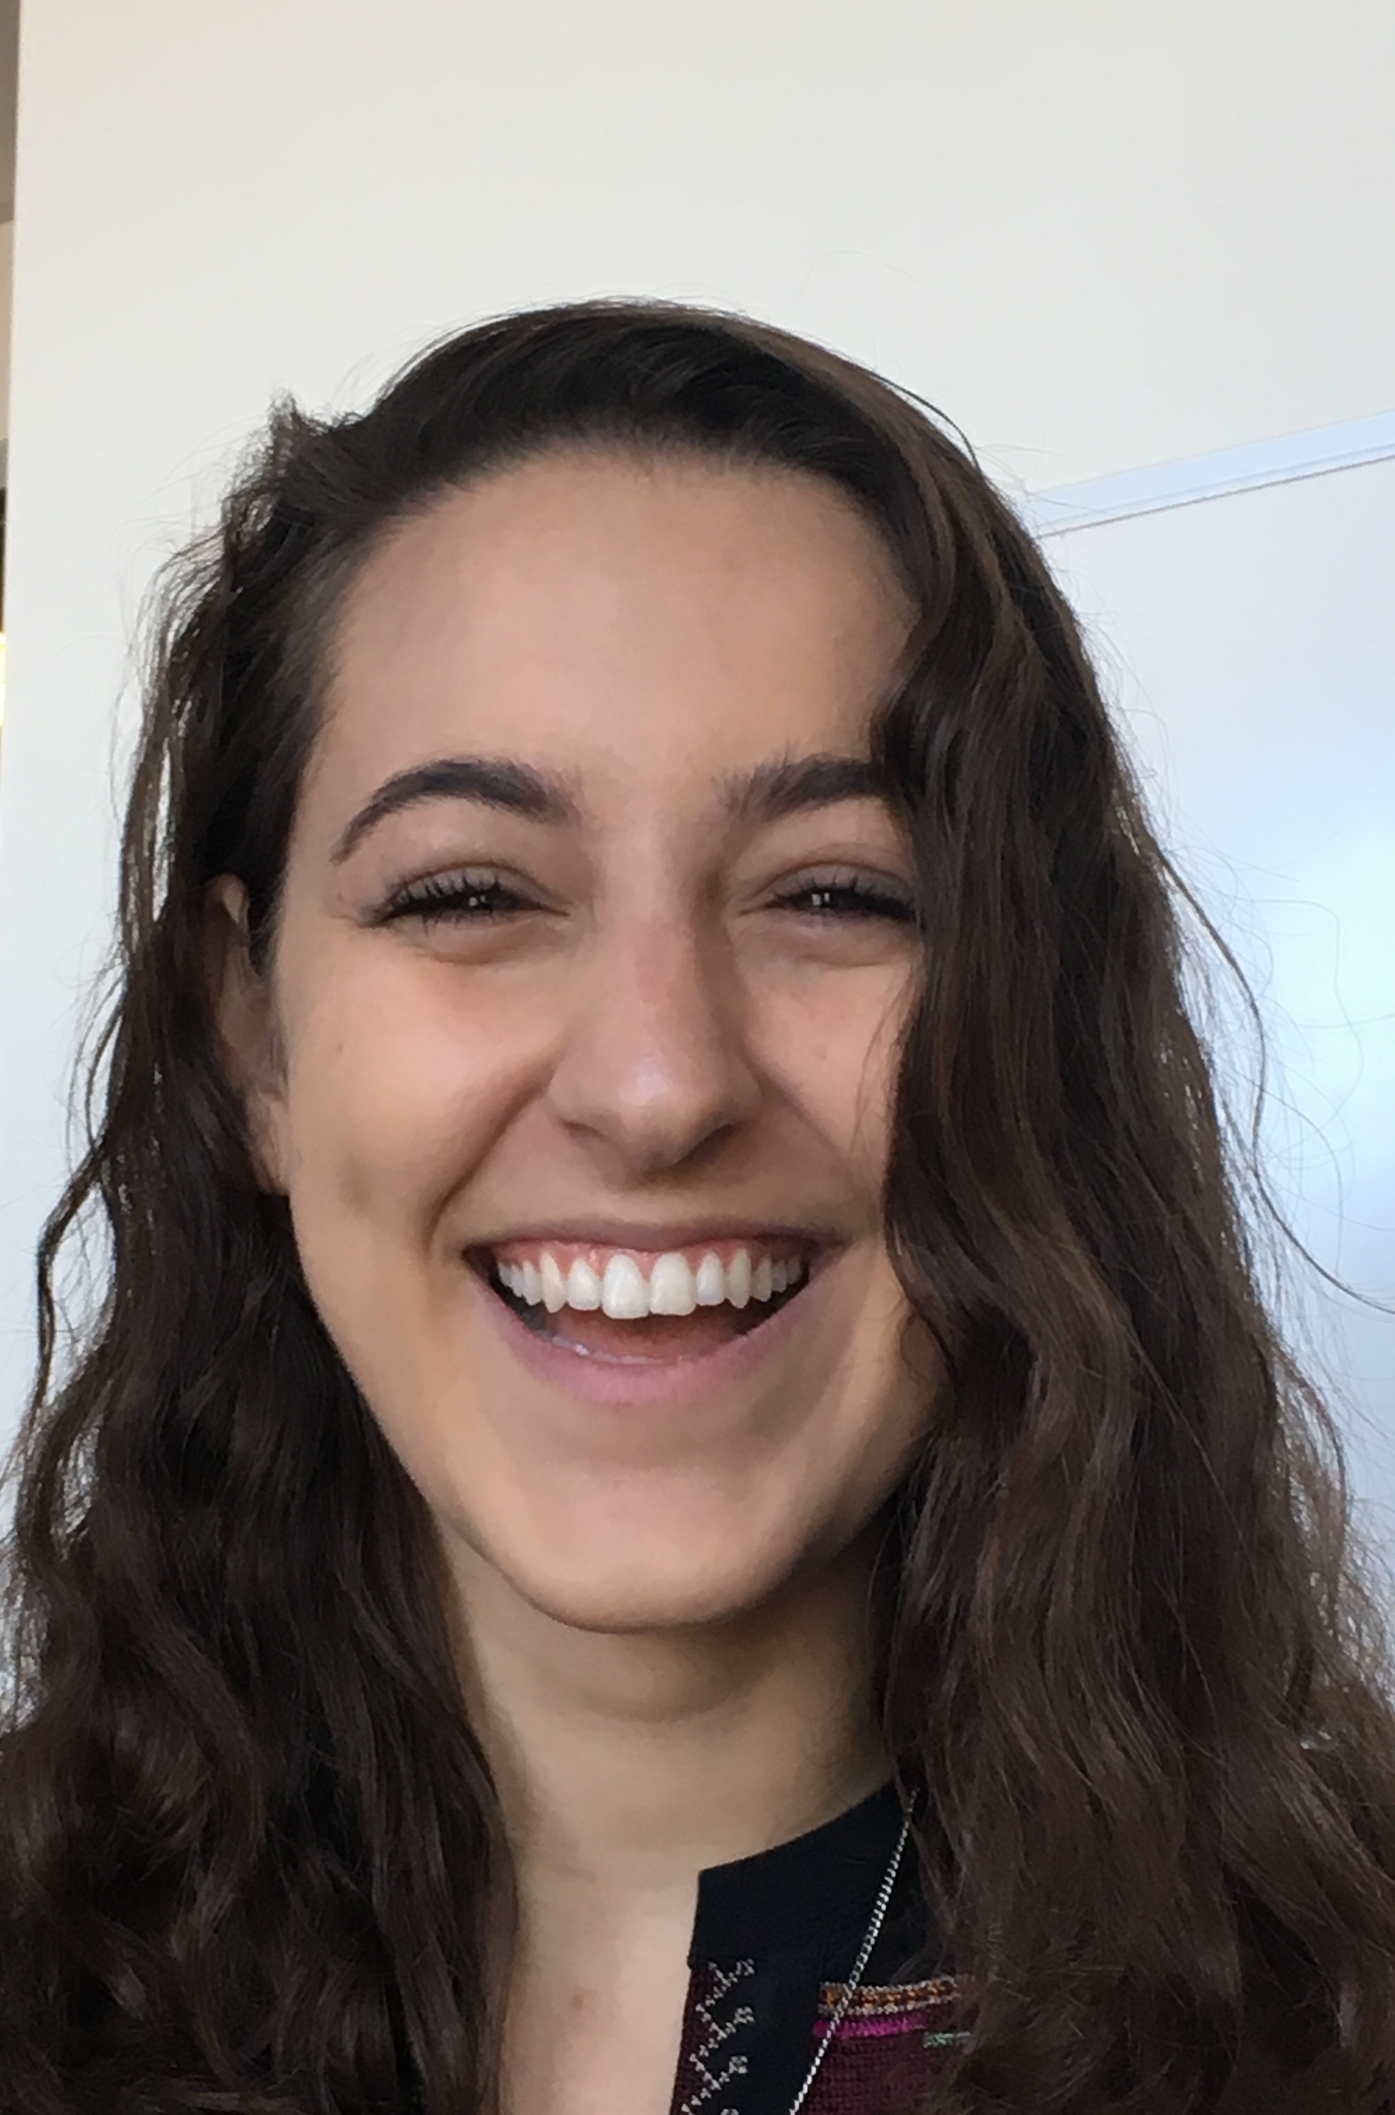
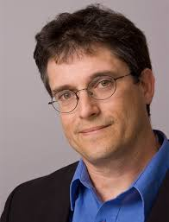
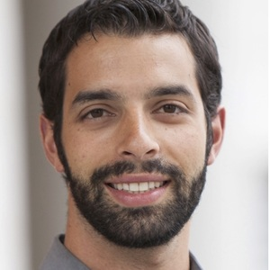
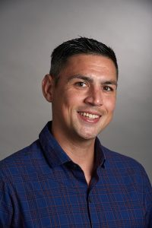

Thanks!
Bruna
Bressane-
Olson
Seppo
Ahlfors
David
Caplan
Sydney
Cash
Jenn
Segawa
Ricky
Sachdeva
Conrad
Nied
Adriana
Schoenhaut
Tom
Sgouros
Mark
Vangel
Corey
Keller
Reid
Vancelette
Supported by R01DC015455
Notes:
In the beginning, rules were prescriptive (and God spoke directly with Charleton Heston)
Descriptive: 19th century linguistics concerned with generating grammars to describe rapidly disappearing native American and other “exotic” languages (Cherokee informant Sequoya who developed written Cherokee syllabary, grammar first mapped by ethnographer James Mooney (1891)
Chomsky’s generative linguistics suggested that rules create structure
Advent of connectionism suggested that complex lawful behavior could emerge from dynamic mapping processes

Slide 45
Granger Causality Analysis of the BOLD Signal (a bad idea)
A few assumptions of GC not met by BOLD data
Uniformity of BOLD response across brain regions
Sampling interval (TR) < rate of network change
Local BOLD responses have no non-local effects of blood flow
X
1. Local dilation
here
X
Blood flow
X
2. Affects downstream
distribution here
Notes:
Speech sound processing in pSTG based on fMRI, iEEG work by Eddy Chang etc.

