Slide 1
Tutorial on Cognitive Neurosciences
Brains, Minds & Machines Summer School 2018
Frederico Azevedo
(fazevedo@mit.edu)
Notes:
Hi. My name is Frederico Azevedo and I am a postdoc at the Center of Brains, Minds and Machines. I will continue the tutorial of basic neuroscience by giving you a glimpse of what the field of cognitive neuroscience is about.
Of course in 40 min I can’t even scratch the surface of the enormous field of cognitive neuroscience so I will have to be fast and very general.
Please feel free to contact me anytime during the course or at this email.

Slide 2
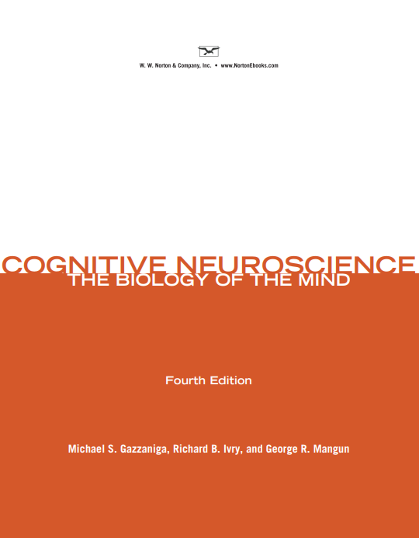
Classic textbooks
Kandel et al.
Principles of Neural Science.
5th ed.
Gazzaniga et al.
Cognitive Neuroscience: the biology of the mind.
4th ed.
Notes:
For the people here in the course who are new in neurosciences, I would recommend 2 classic textbooks.
The first one is the Kandel et al, Principles of neuroscience
And the second one is Gazzaniga et al: Cognitive Neuroscience: the biology of the mind
The material contained in those books is definitely worthy it as an introduction.
Ah, just as a curiosity, the term cognitive neuroscience was coined by the first author of the second book, Michael Gazzaniga, together with cognitive psychologist George Miller, in the backseat of a taxi in NYC.

Slide 3
Cognitive + Neuroscience
Cognition: the mental action or process of acquiring knowledge and understanding through thought, experience, and the senses*
Neuroscience: the science of the structure and function of the nervous system
How the brain enables the mind
* Oxford dictionary
Notes:
The term cognitive neuroscience is obviously a concatenation of the terms cognition, which is the
the mental action or process of acquiring knowledge and understanding through thought, experience, and the senses
And the term neuroscience, which is the
the science of the structure and function of the nervous system.
If you want to put in simpler words, the aim of the field of cognitive neuroscience is to understand how the brain enables the mind.

Slide 4
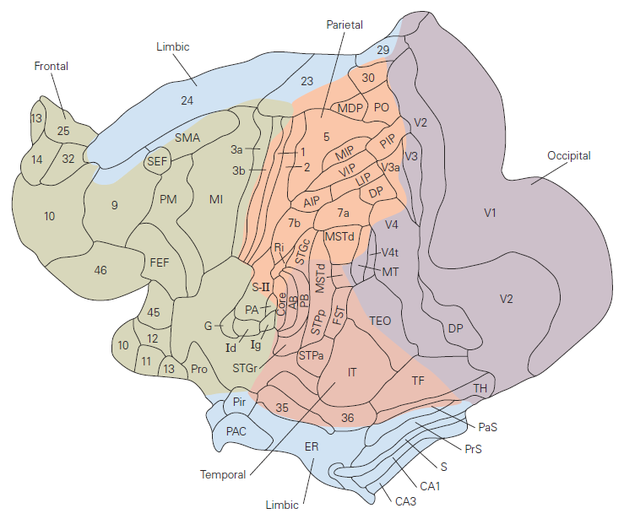
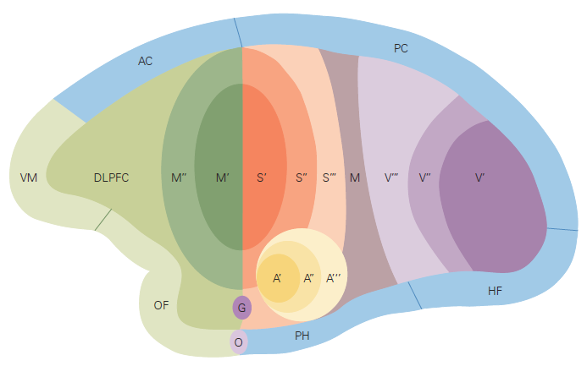
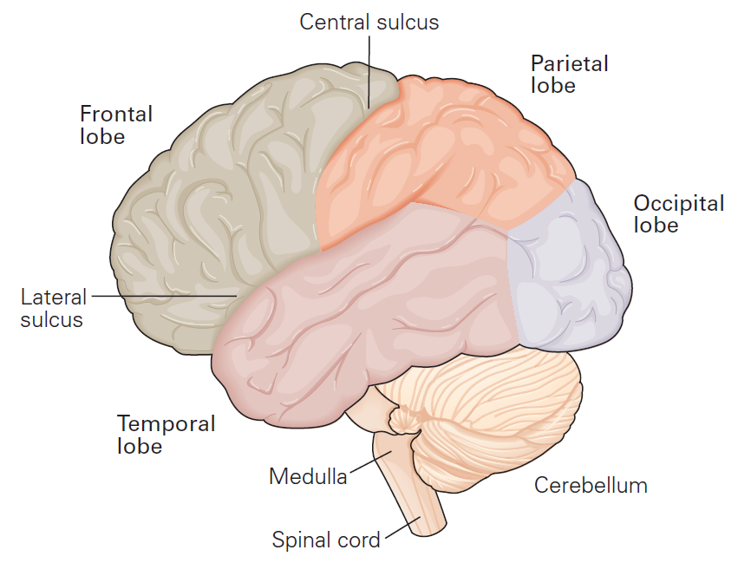
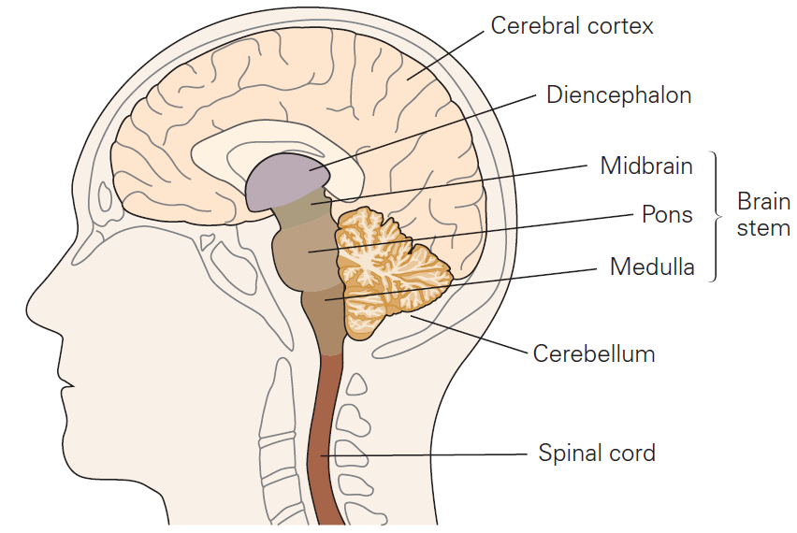
From anatomy to function
Adapted from Kandel et al. Principles of Neural Science. 5th ed.
Notes:
Well, the central nervous system is composed of the spinal cord and the brain.
The brain, with its approximately 86 billions neurons and a similar number of non-neuronal cells, is composed of cerebellum, brain stem, diencephalon and cerebral cortex but also of the underlying white matter, basal ganglia, amygdala and hippocampal formation, which are not represented in this figure.
The cerebral cortex, which is very developed in primates, is the main player in cognition. Anatomically it is organized in 6 layers of neurons in a columnar fashion.
It can be further subdivided in 4 to 6 lobes, depending on the author. We have the occipital lobe, the temporal lobe, the parietal lobe, the frontal lobe, the limbic lobe and the insular lobe.
Each of those lobes can be further divided into anatomically and functionally defined brain areas [click]. Those areas are distinguished by cellular structure, connectivity and physiological response of the neurons.
Note that I’ve just changed the figure from human brain to a monkey brain. I’ve done this because normally in order to classify the physiological responses of neurons, invasive methods are required; therefore a model of the human brain is necessary.
So, coming back to the cerebral cortex, it’s very useful to display it in a flatmap like this figure in the middle. Imagine that you open one hemisphere of the brain and you stretch its surface. Of course there are distortions but this way of visualizing allows you to see the whole cortical surface of one whole hemisphere at once.
By doing so, some characteristics of the brain become very obvious. For instance, we can immediately see that functionally related areas of the brain tend to stick together:
Visual areas are here, somatosensory areas are here, motor areas here and so on.
---
Kandel 394

Slide 5
Core cognitive processes
Perception
Action
Attention
Learning & Memory
Language, Emotion, etc …
Notes:
Now that you know everything you can possibly know about anatomy and function of the brain, let’s talk a bit about the core cognitive processes.
Due to time limitations, I won’t be able to cover every cognitive process. So, I will go briefly into perception, action, attention and learning & memory.
Other cognitive processes such as emotion and language will be discussed by other speakers during the course.

Slide 6
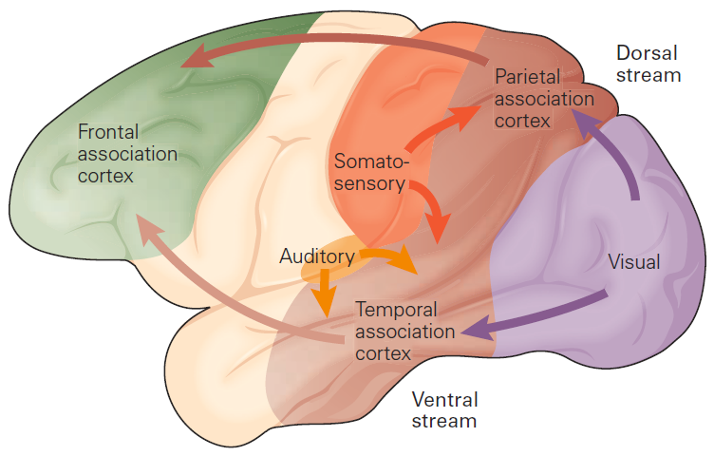
Two-streams model
Adapted from Kandel et al. Principles of Neural Science. 5th ed.
Notes:
Francisco already showed you how the sensory inputs reach the primary sensory cortices but what happens from there on?
Generally, after the inputs reach the lower order sensory cortices, they are dichotomized and sent in parallel to the parietal and temporal association cortices. After that, both streams are sent to the dorsal or ventral frontal association cortex respectively. After being processed in the frontal cortex, depending on the outcome, neural signal can be sent back to lower order areas and modulate further input or processing.
The processing of neural signals from lower-order to higher order areas is called as bottom-up or feedforward processing and the processing of signal from higher-order areas to lower-order sensory areas is called top-down or feedback processing.
Concerning feedforward processing, the general pattern is that while the dorsal parietal stream is mainly processing spatial features of the sensory object, the ventral temporal stream processes the identity and associated features of the sensory object, such as emotional responses.
The dual stream hypothesis with a dorsal pathway processing spatial features and the ventral pathway processing visual features was first proposed by Mishkin and Ungerleider in 1982. The pathways are also known as the what and where pathways. After that, similar models have been proposed for other sensory modalities such as auditory and somatosensory modalities.
Here I will focus on the visual modality.
----
Kandel 397

Slide 7
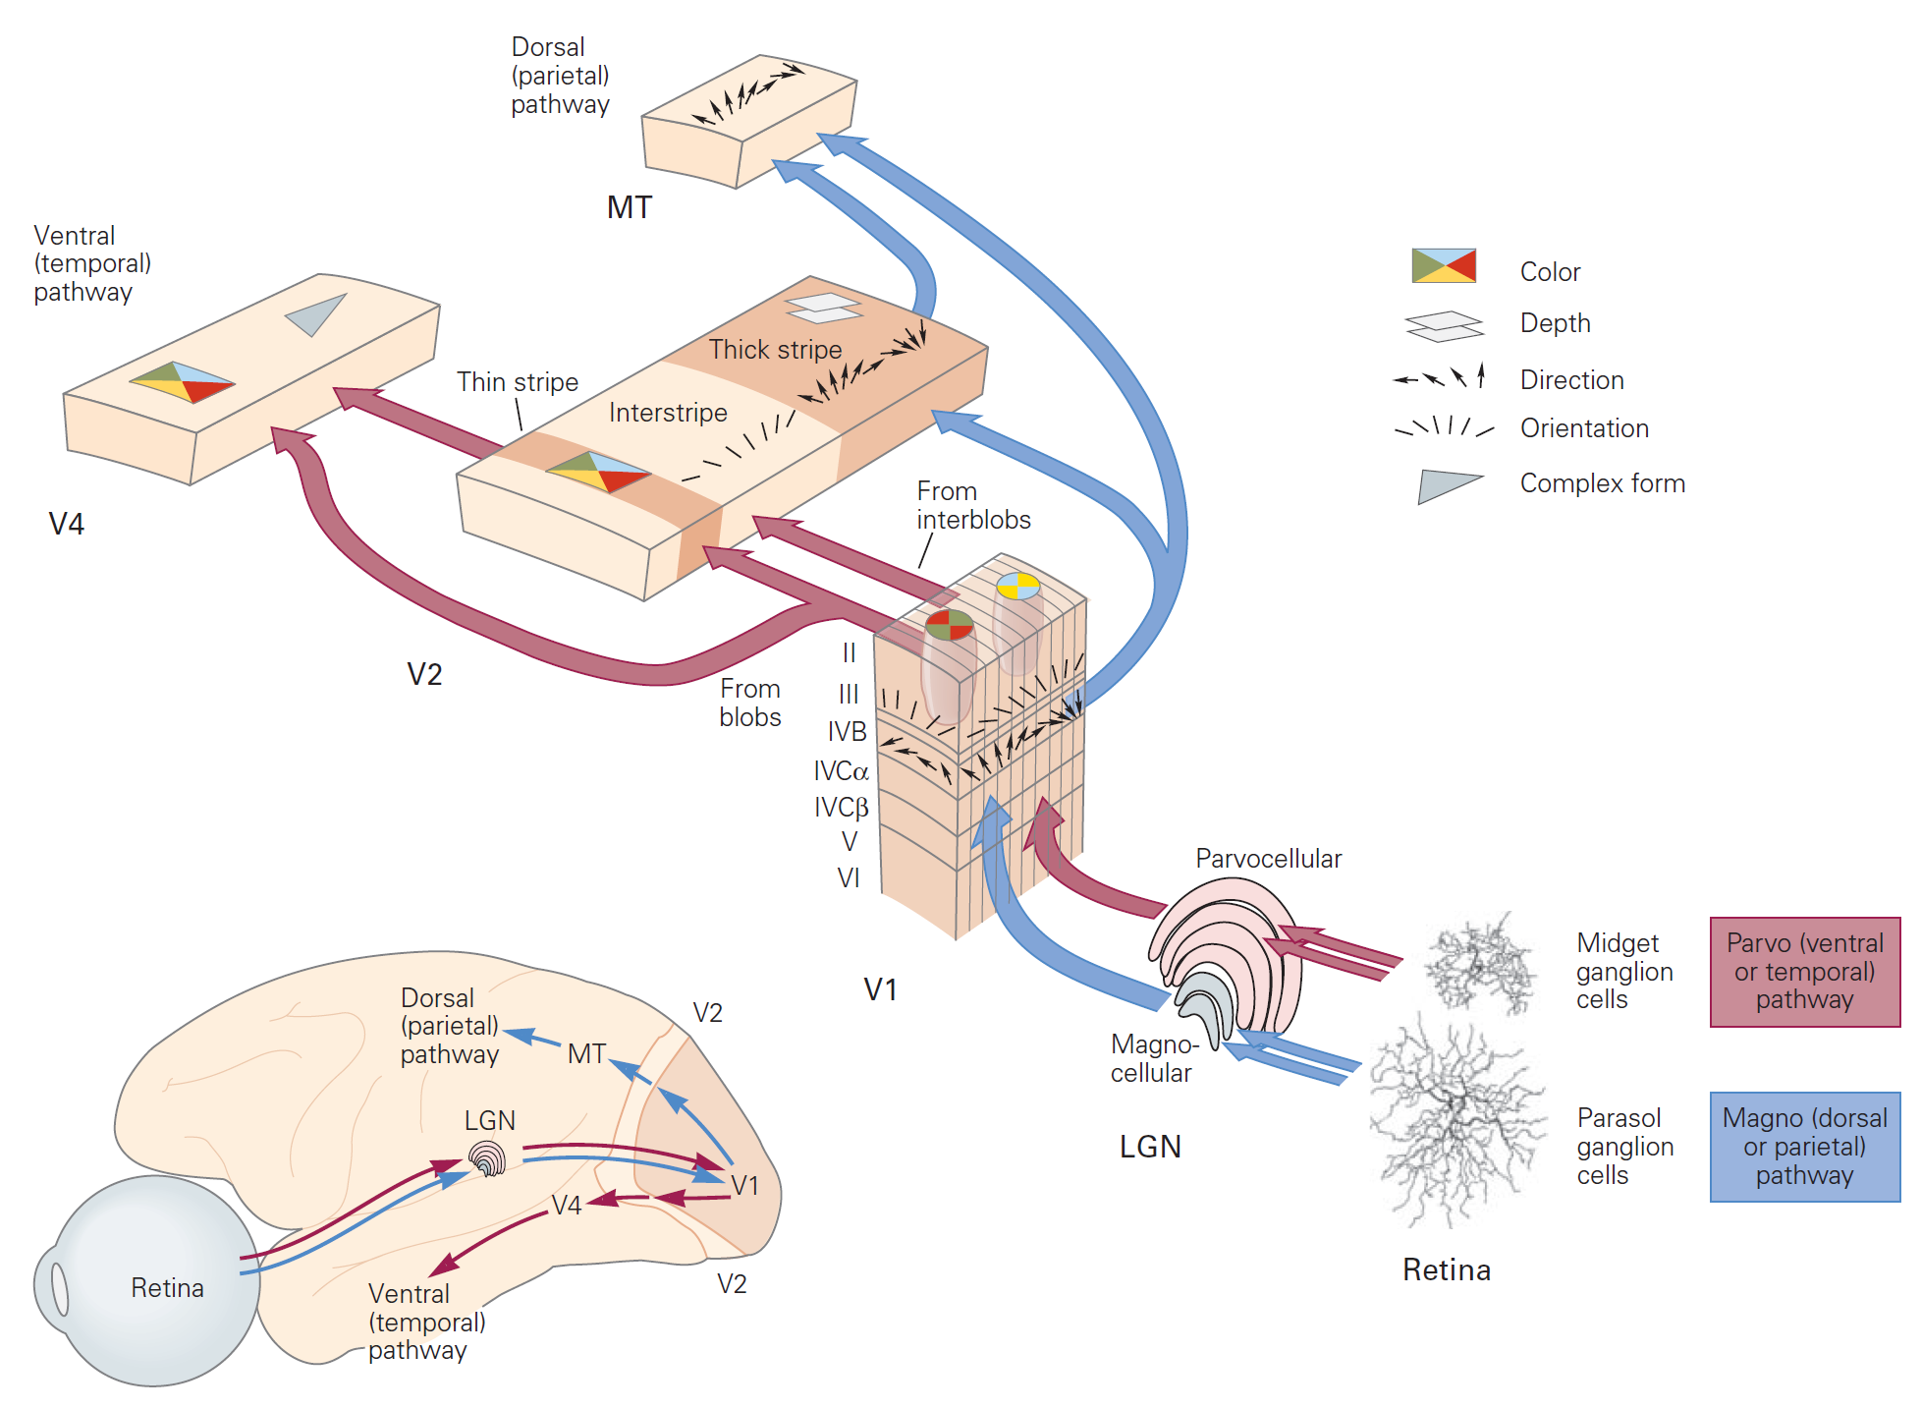
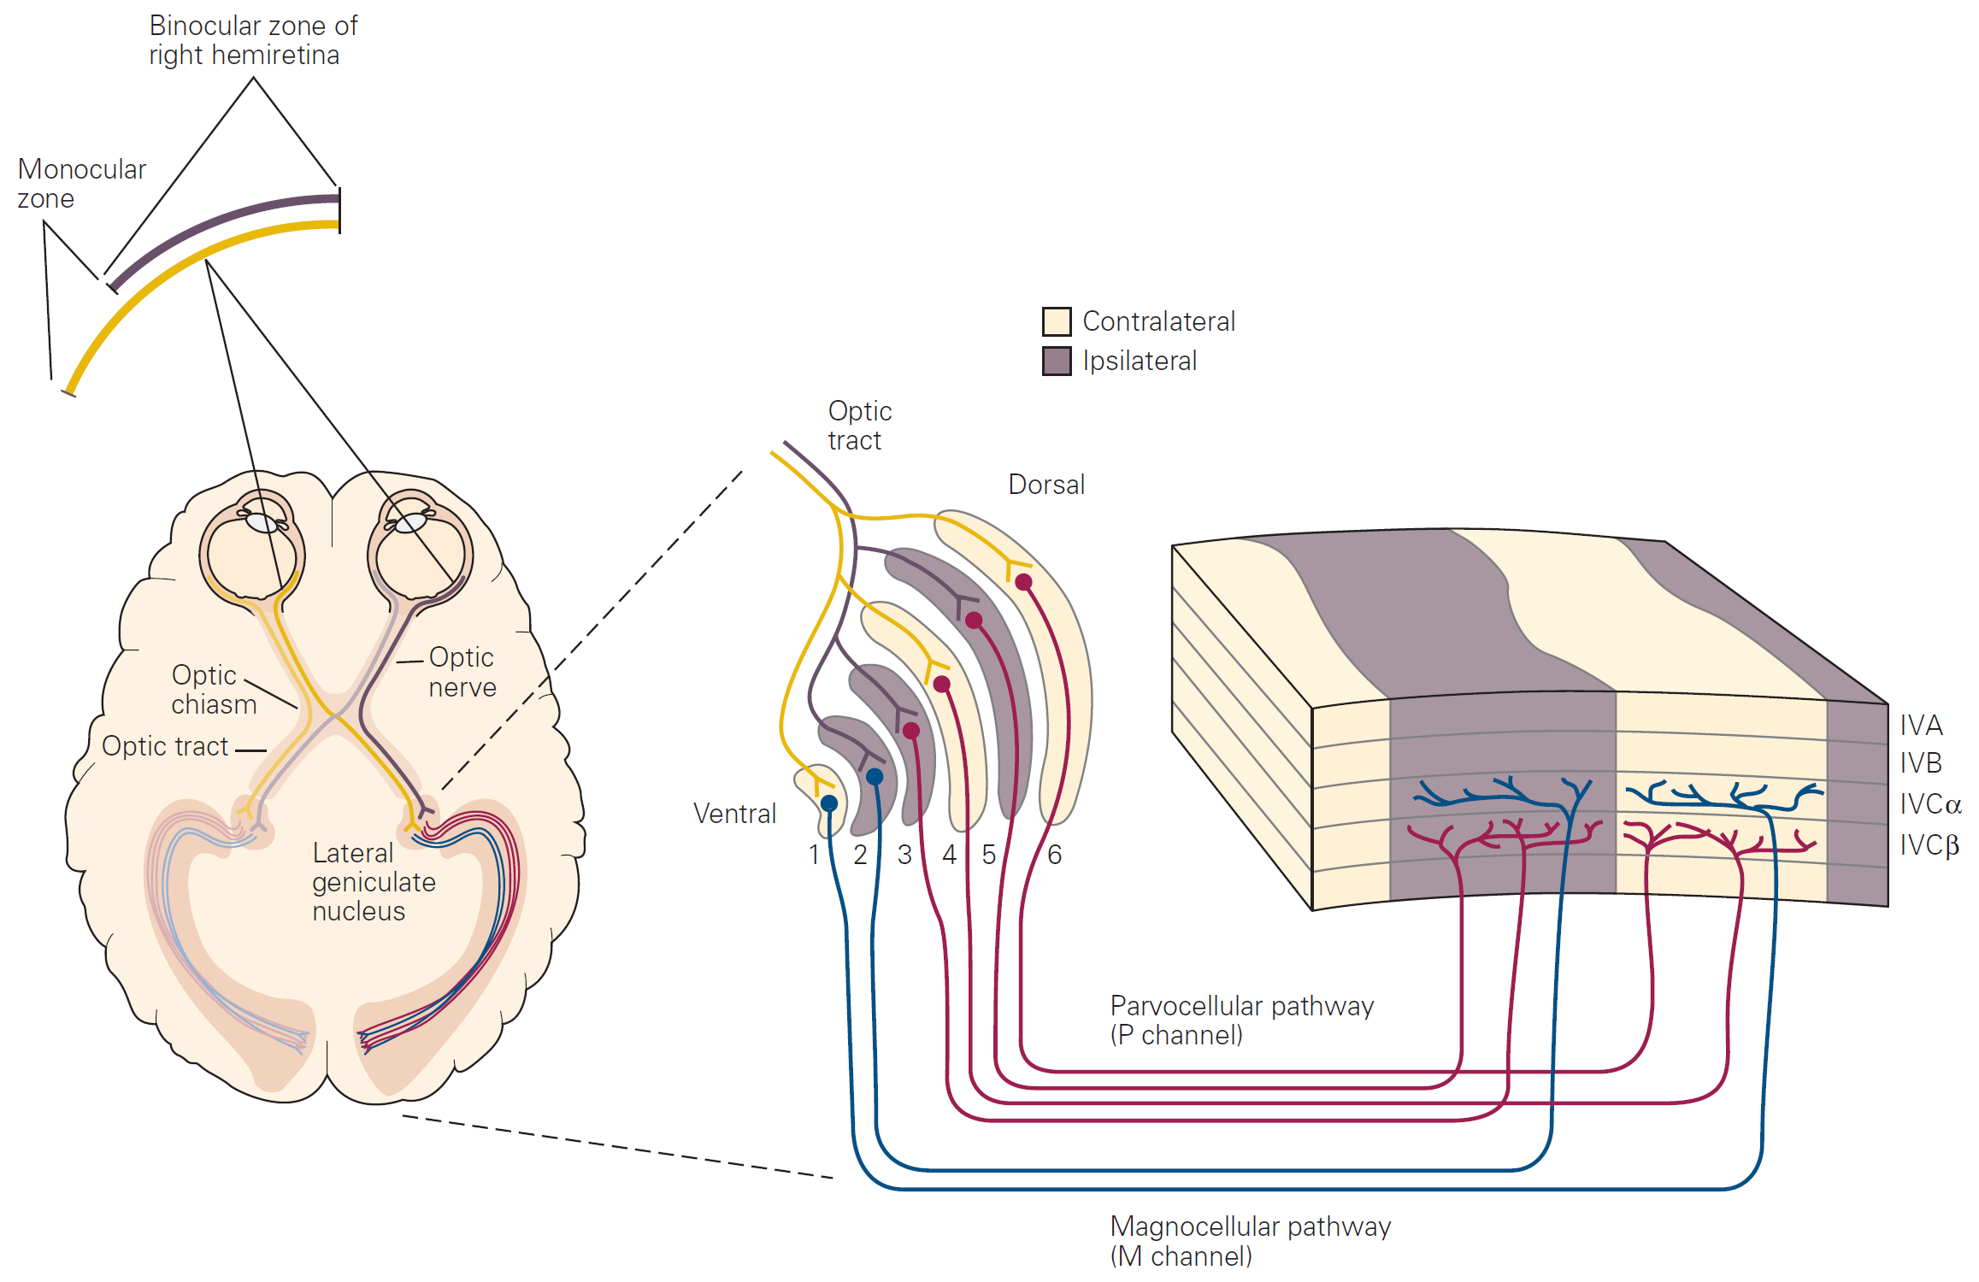
Visual processing
Adapted from Kandel et al. Principles of Neural Science. 5th ed.
Notes:
So, in a very simplistic overview, light comes from the eyes is focused in the retina, then is passed to the Lateral Geniculate Nucleus, then to V1 and V2 and then it dichotomizes in the dorsal and ventral pathways.
You can see here that simple features such as direction and orientation are extracted in earlier areas and they are bound in more complex features as processing goes further up.
So, we can see that visual processing and general sensory processing occur in a hierarchical way.

Slide 8
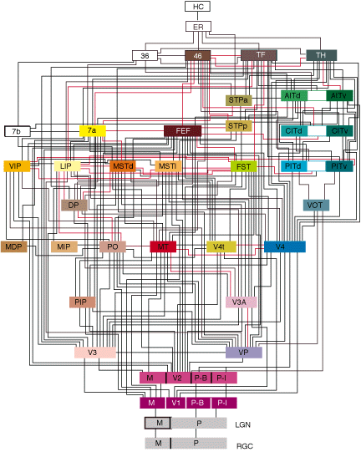
Distributed hierarchical processing
Felleman & Van Essen (1991) Cereb Cortex
Notes:
Of course visual processing in reality isn’t that simple.
In this slide you can see a classic connectivity scheme proposed for Felleman and Van Essen in 1991 for the distributed hierarchical processing of the visual system. In the bottom we have lower-order sensory areas such as LGN and V1 and as we go up higher-order visual areas come into game.
A direct consequence of such hierarchical processing is the existence of areas specialized in processing specific classes of objects, such as faces.

Slide 9
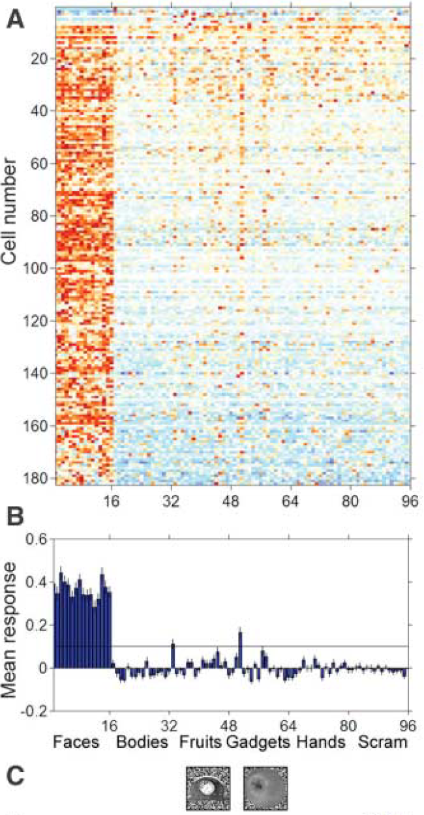
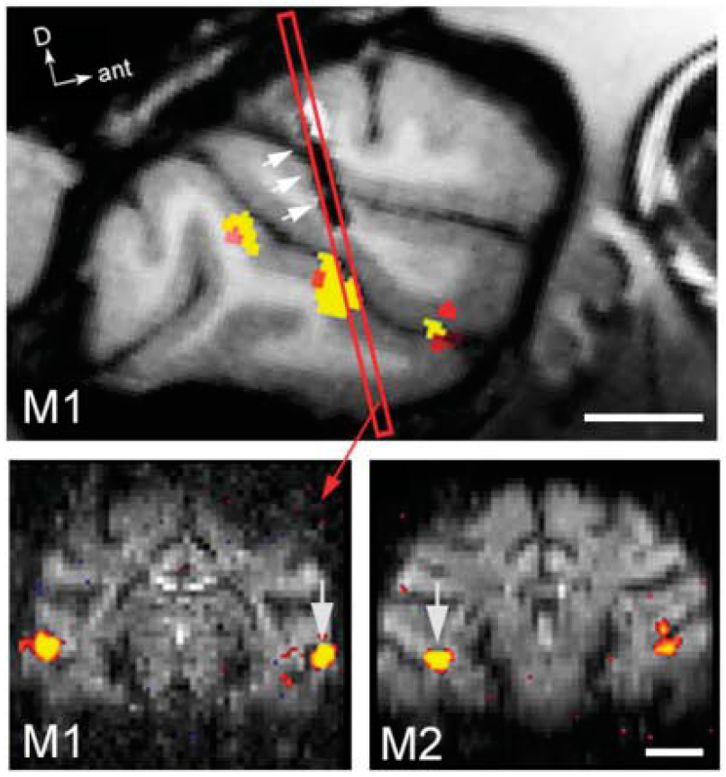
Face processing area
Tsao & Freiwald et al. (2006) Science
Notes:
One study that shows the existence of a specialized face processing area in monkeys which I find very elegant was done in 2006 by doris tsao and winrich freiwald.
Basically they put two monkeys in the scanner while they were shown different kinds of visual stimuli, which included faces. Then they identified face patches along the superior temporal sulcus. Here we can see 3 of them. After that, they inserted an electrode and found that 97% of the cells in the middle face patch were selective responsive to faces.
In humans, there’s also an area dedicated to face processing, the face fusiform area, or FFA.

Slide 10
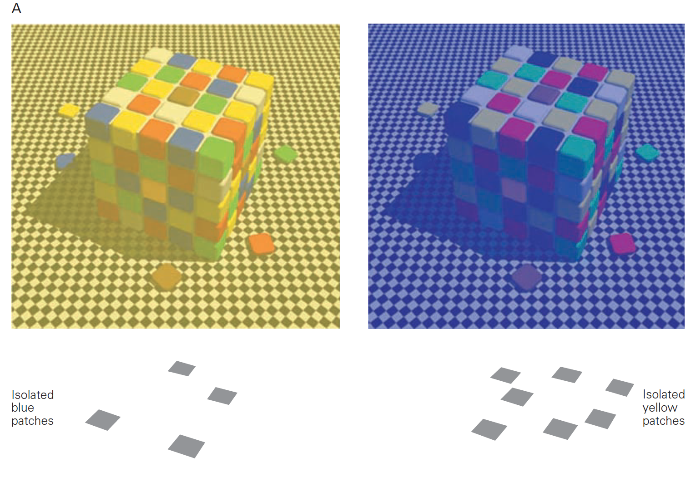
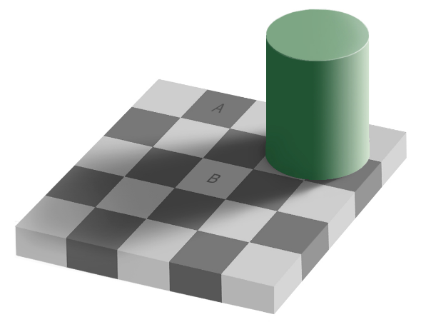
Context matters
Heydt et al. (1984) Science
Notes:
The last thing that I would like to point out about visual perception is that context matters.
Our brains are always trying to process visual input according to the context. For instance, in a our brain interprets this image as 3 black circles and 2 triangles, while in fact there are only 3 angles and 3 pac-mans. Again, why do we see a continuous line in B but not in C? Is there really a tortuous line in D?
The effect of context can be seen even in neural recordings. For instance, in this figure, the authors recorded from a neuron in V2. This neuron was responsive for the transition of the border of this rectangle of light, which moved in one direction. In other words, every time the border would cross the receptive field of this neuron, it would fire. The interesting part was that the same neuron would fire more even if there was an illusion of a border. In this case, the authors covered the whole receptive field and moved the same rectangle of light over it. Note that in this case, there isn’t any transition in the receptive field. However, if the same experiment was done with only one half of the rectangle of light, the neuron wouldn’t respond.
Other examples that I like have to do with colors. For instance, I can show to you that this blue and yellow patches are actually gray!
And that A and B in this picture have the same gray level!
Unbelievable, right?

Slide 11
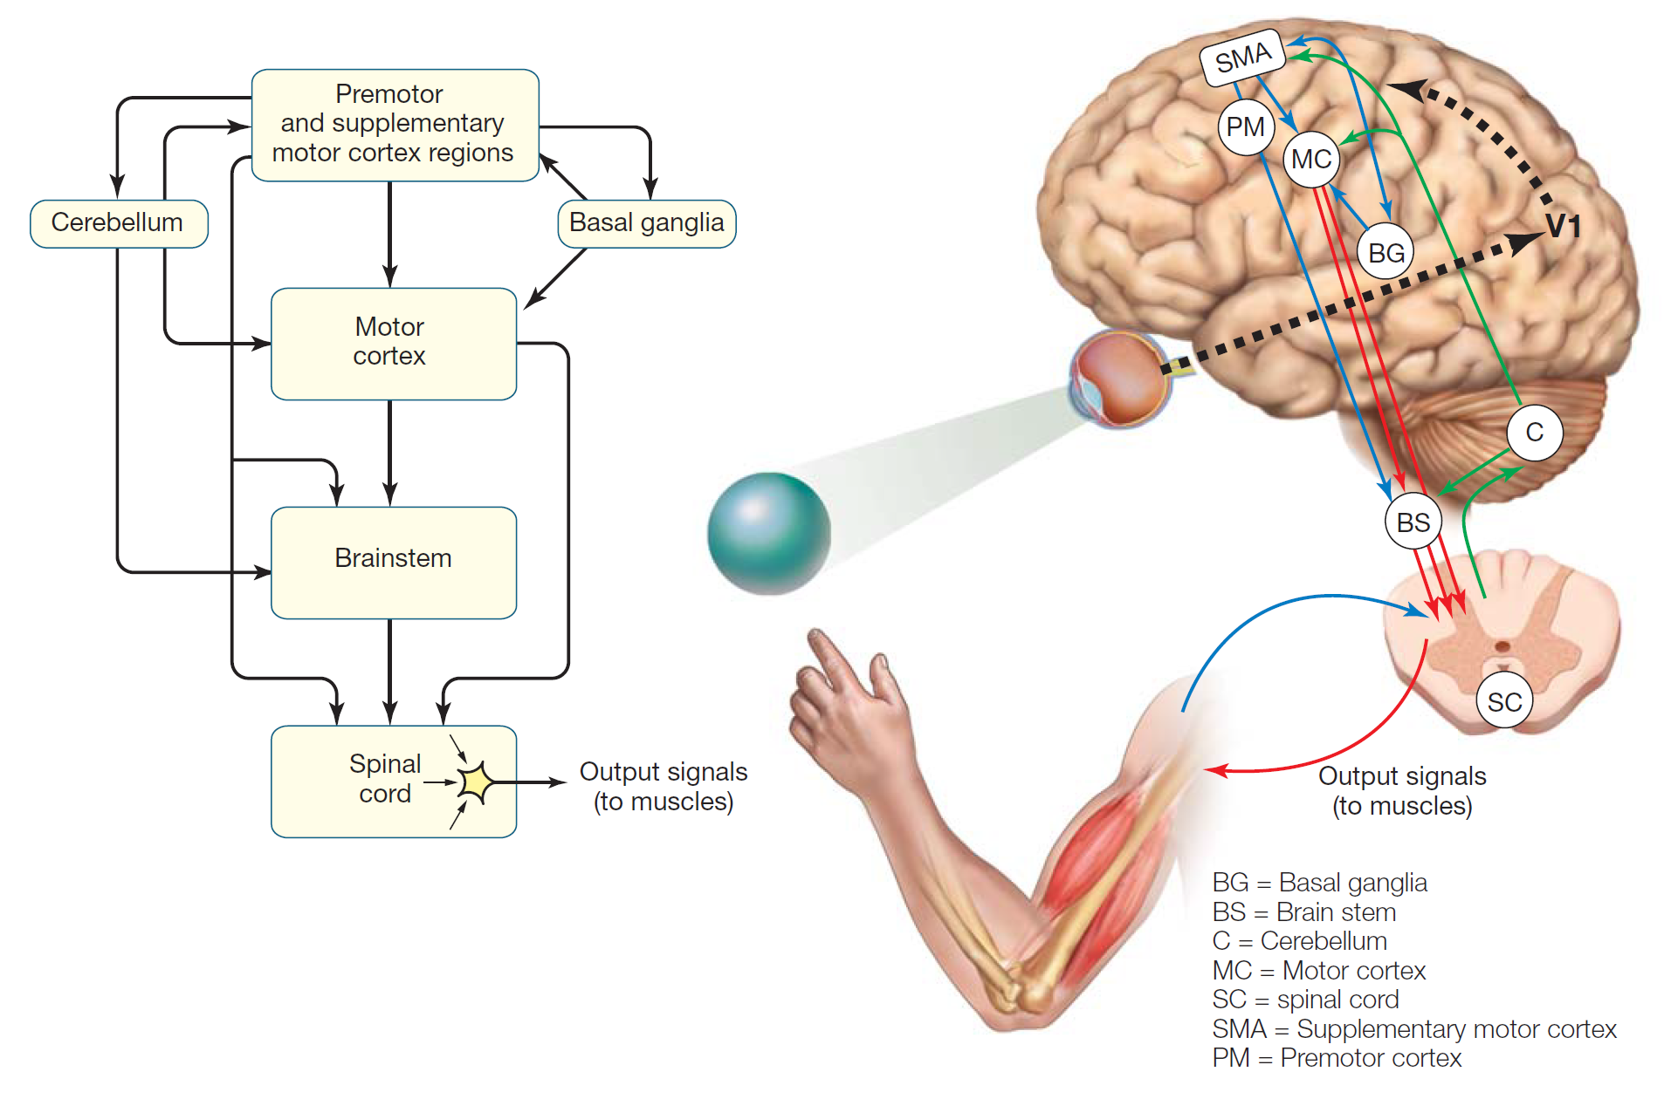
Action
Gazzaniga et al. Cognitive Neuroscience: the biology of the mind. 4th ed.
Notes:
Anyway, let’s move on to action now.
The motor system is also organized in an hierarchical fashion. Motor signals come from premotor and supplementary motor cortex regions. Those regions are responsible for planning the action based on the current goal, perceptual input and past experience.
Then the plan of the action is transformed into an execution command after being processed in the motor cortex, basal ganglia and cerebellum.
After that the commands are passed to the brain stem and spinal cord to reach the limbs creating movement.
It’s important to note that there is a constant interplay of action and sensory feedback to fine tune further actions. This is called sensorimotor integration.

Slide 12
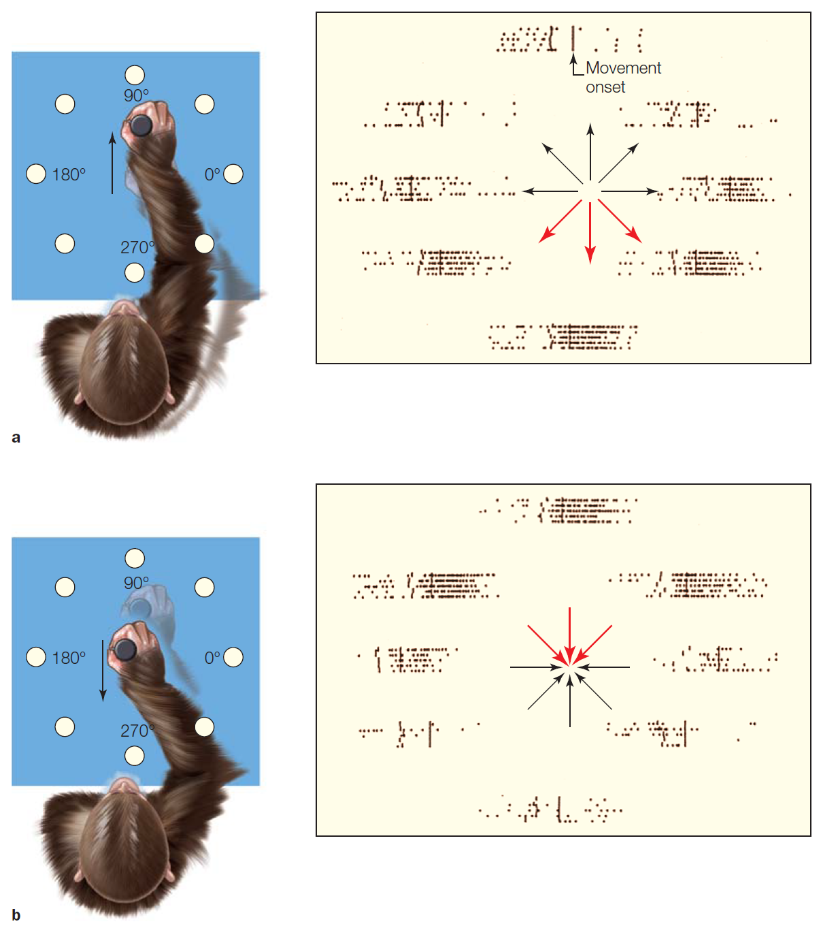
Decoding of movement
Gazzaniga et al. Cognitive Neuroscience: the biology of the mind. 4th ed.
Notes:
It’s possible to decode the intention of movement before it has been sent to the limbs. For instance, if you train a monkey to move a lever in all directions, you can decode the direction of movement directly from electrophysiological signals in the motor cortex.
---
Gazzaniga 343

Slide 13
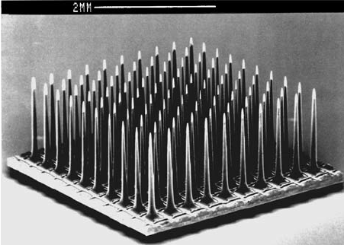
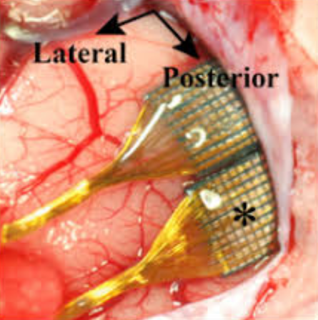
Decoding of movement
Blackrock Microsystems
Davies et al. (2012) J Neur Eng
Andrew Schwartz group
Notes:
One application of that is to move robotic limbs using brain machine interfaces.
In this case here, the group of Andrew Schwatz implanted Utah arrays, which are a matrix of arrays as displayed here, in the motor cortex of monkeys. After some training, the monkeys were able to move a robotic arm in order to take a marshmallow and to bring it to their mouths.
Nowadays this technology has been translated to humans and many patients are able to move prosthesis with their thoughts.
----
https://www.youtube.com/watch?v=wxIgdOlT2cY

Slide 14
Attention
“the process by which organisms select a subset of available information upon which to focus for enhanced processing (often in a signal-to-noise-ratio sense) and integration” Laurence M. Ward
Notes:
Moving on, let’s talk a bit about attention now.
By definition, attention is “the process by which organisms select a subset of available information upon which to focus for enhanced processing (often in a signal-to-noise-ratio sense) and integration”
In other words, attention boosts the of signal-to-noise ratio by inhibiting processing of unattended stimuli and enhancing processing of attended stimuli.
There are different kinds of attention and they span different sensory modalities. Again, I will focus on two types of visual attention.

Slide 15
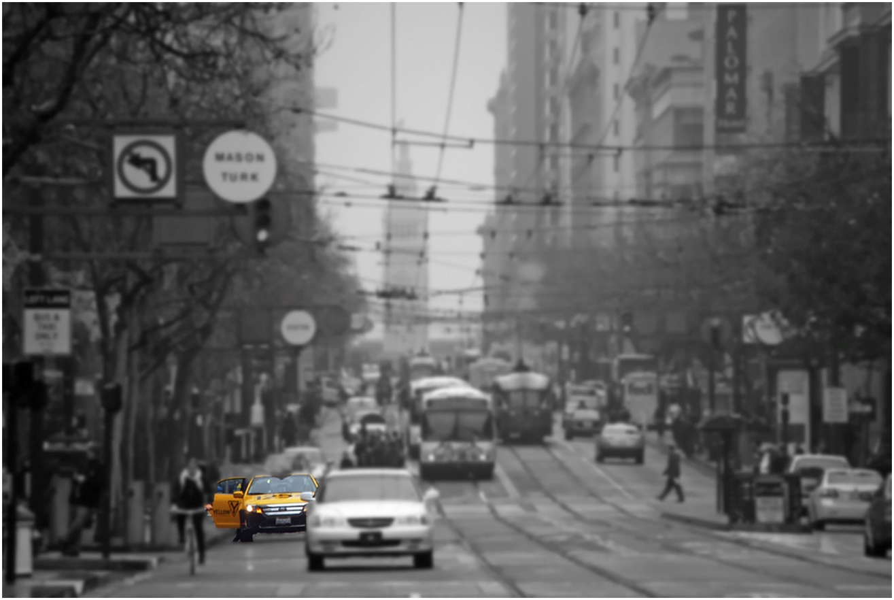
Feature-based attention
Spatial attention
Adapted from Moore & Zirnsak (2015) Neuron
Notes:
In a visual scene, attention can be directed to a specific place such as the dashed circled presented here or to a different feature, such as the yellow color. Note that you don’t need to be gazing straight to the center of attention. Attention can be covertly deployed in the periphery.
The general result of attention is an increase in firing rate for either the place or the visual feature being focused.
Well, in fact, …

Slide 16
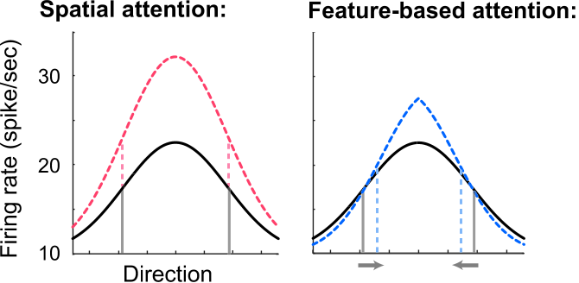
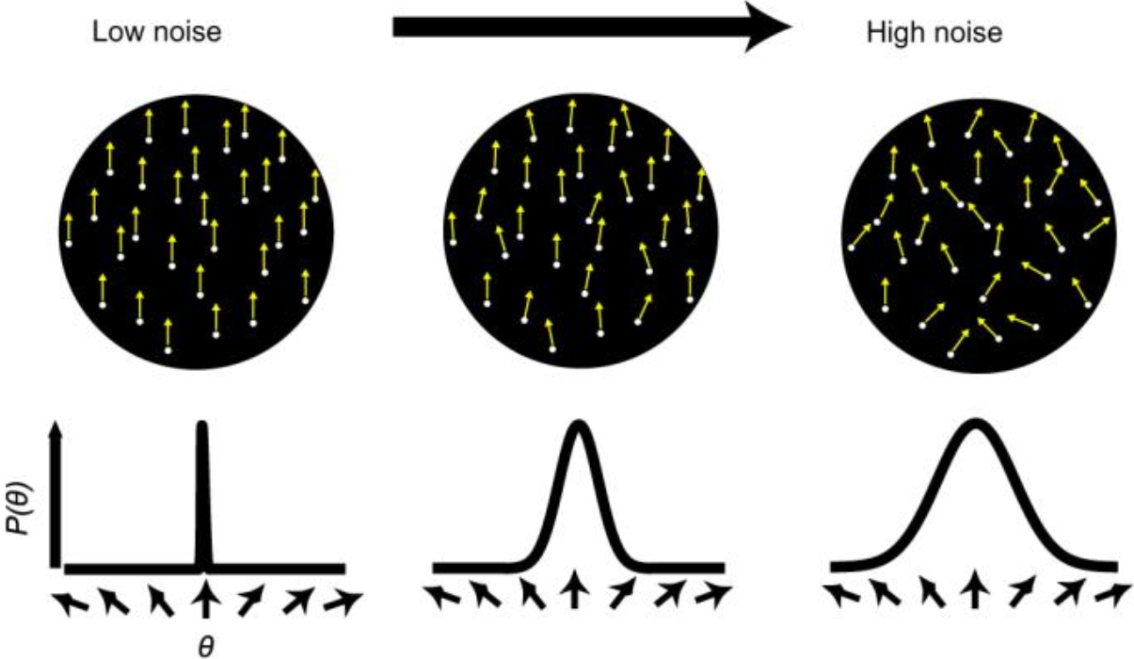
Modulation of population response
Increase in firing rate + sharpening of response (tuning)
Increase in firing rate
Ling et al. (2009) Vision research
Notes:
Well, in fact, attention acts in different ways. While the general effect of spatial attention is an increase in firing rate, for feature-based attention, besides an increase in firing rate, you can have a sharpening of the neuronal response curve. The sharpening of the tuning curve works as if the noise of the stimulus would be reduced.
------
https://www.semanticscholar.org/paper/How-spatial-and-feature-based-attention-affect-the-Ling-Liu/b4514b0fe92fdbb857df774a4185f1632cb2e3a8

Slide 17
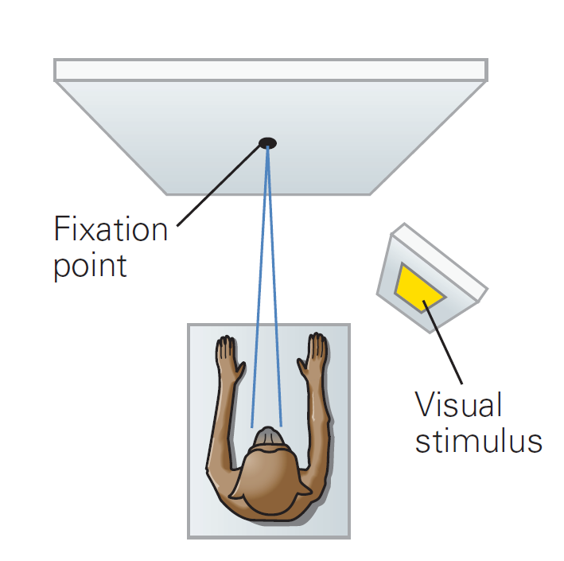
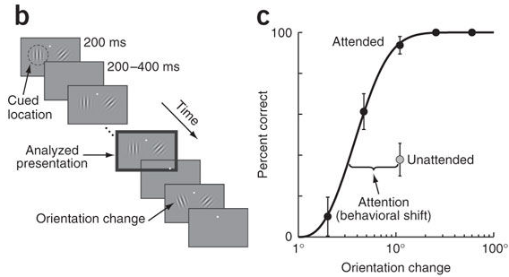
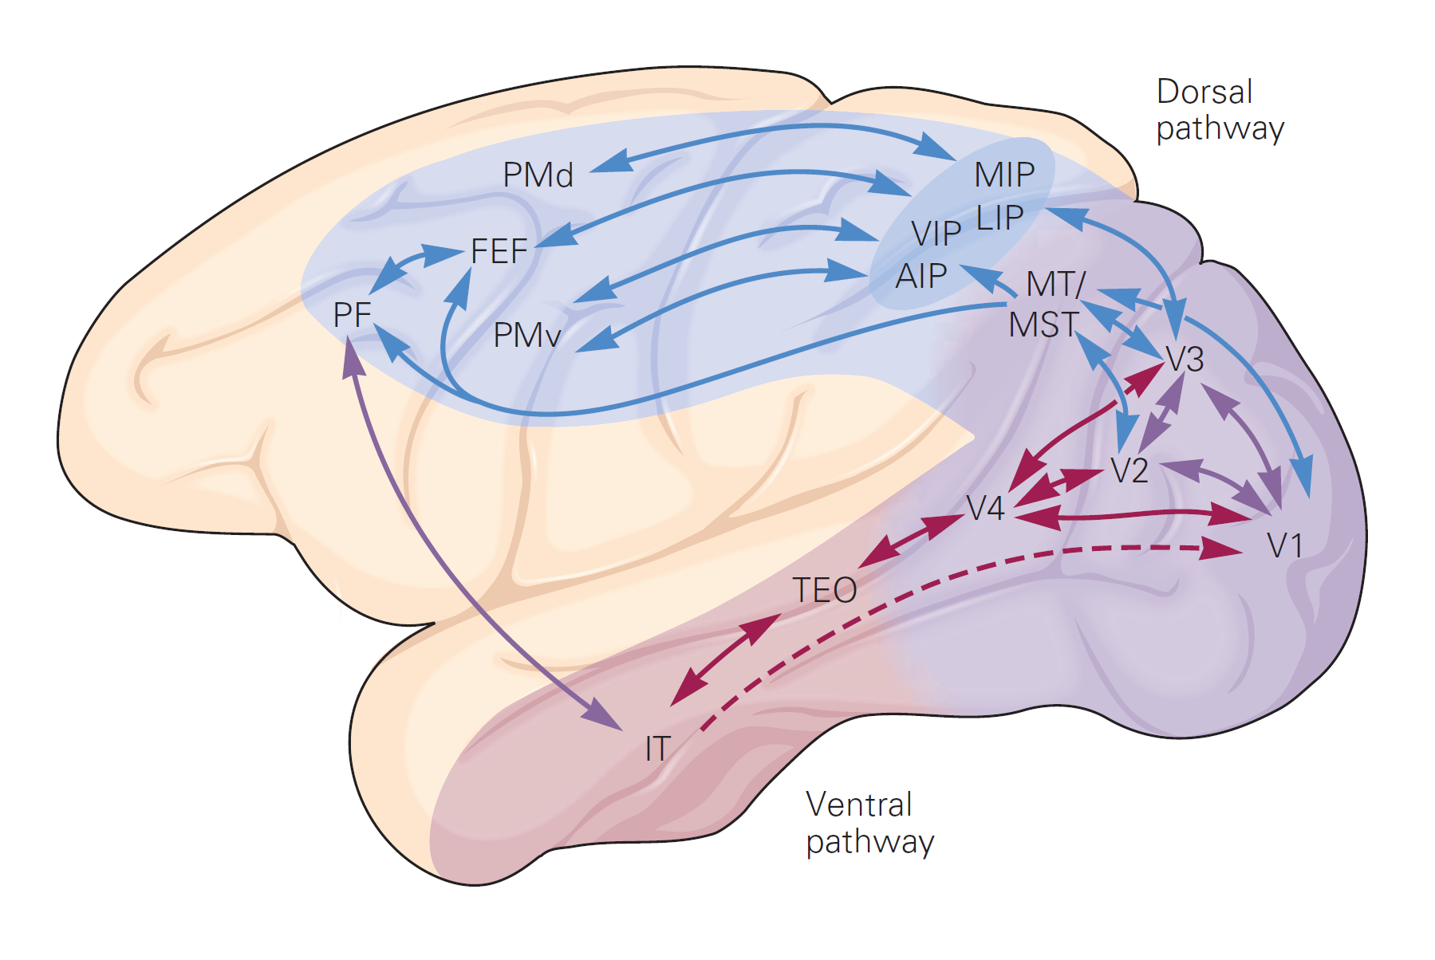
Visual spatial attention enhances firing rate in V4
a
b
c
d
e
Electrode
a, d: adapted from Kandel et al. Principles of Neural Science. 5th ed.
b, c, e: Adapted from Cohen & Maunsell (2009) Nat Neurosci
Notes:
The neural correlates of spatial visual attention can be detected in an experiment such as this one. You train a monkey to keep fixation centrally and to respond to a classic posner covert attention stimulus. In this paradigm, the monkey has to …
You train it until you see that there’s an statistically significant increase in detection sensitivity by the monkey. After that, if you record from a V4 neuron selective for orientation, you can see that this neuron will fire more if he is attending to the side of the orientation change.
---

Slide 18
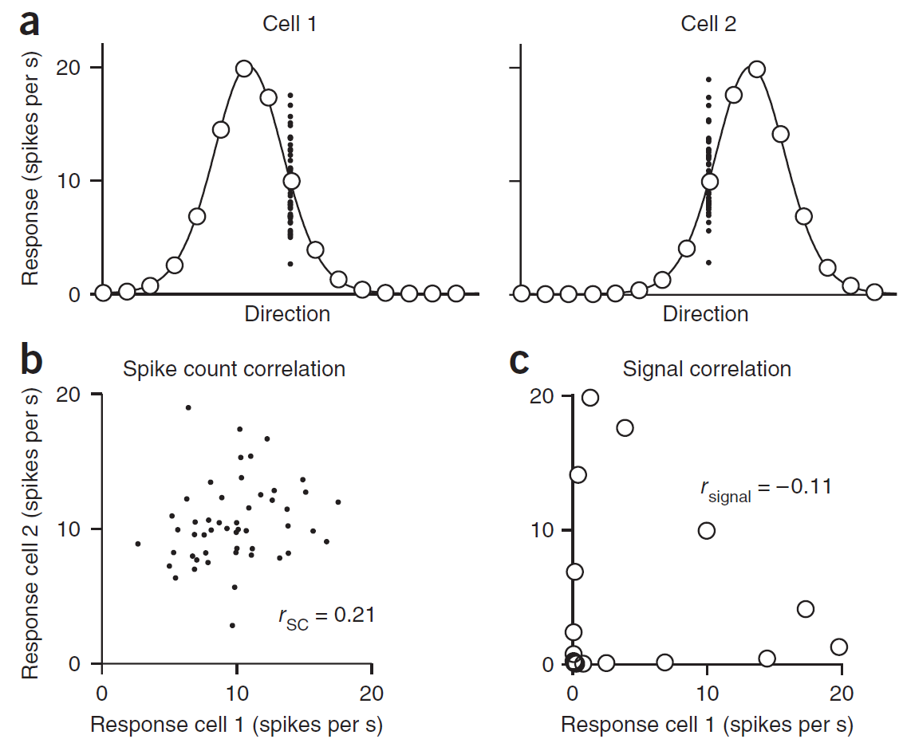
Attention improves performance by reducing noise correlations
Adapted from Cohen & Kohn (2011) Nat Neurosci Rev
Notes:
Teh
Well, let’s start by considering only one neuron, in this case a direction selective cell. Every time we present the same stimulus to which the neuron is responsive, on average we will get an increase in spiking rate. However, the total number of spikes won’t be the same. There will be a variance in the response. In this figure, the black dots represent the response of the cell to individual trials and the white circles, the average spike count.
Now, if you record from 2 direction selective neurons at the same time, we will see such a variability in responses on both neurons.
Interestingly, if you plot the responses of both neurons for repeated presentations of the same stimulus for each trial, the responses of both neurons will be typically correlated. For instance, it can be that every time one neuron shows a big spike count, the other shows also a big spike count… and when the neuron 1 shows small spike count, neuron 2 shows also a small spike count. This correlation in the variability of responses in pairs of neurons is called correlated variability (or noise correlations or spike count correlations or rsc).
Attention decreases noise correlations.

Slide 19
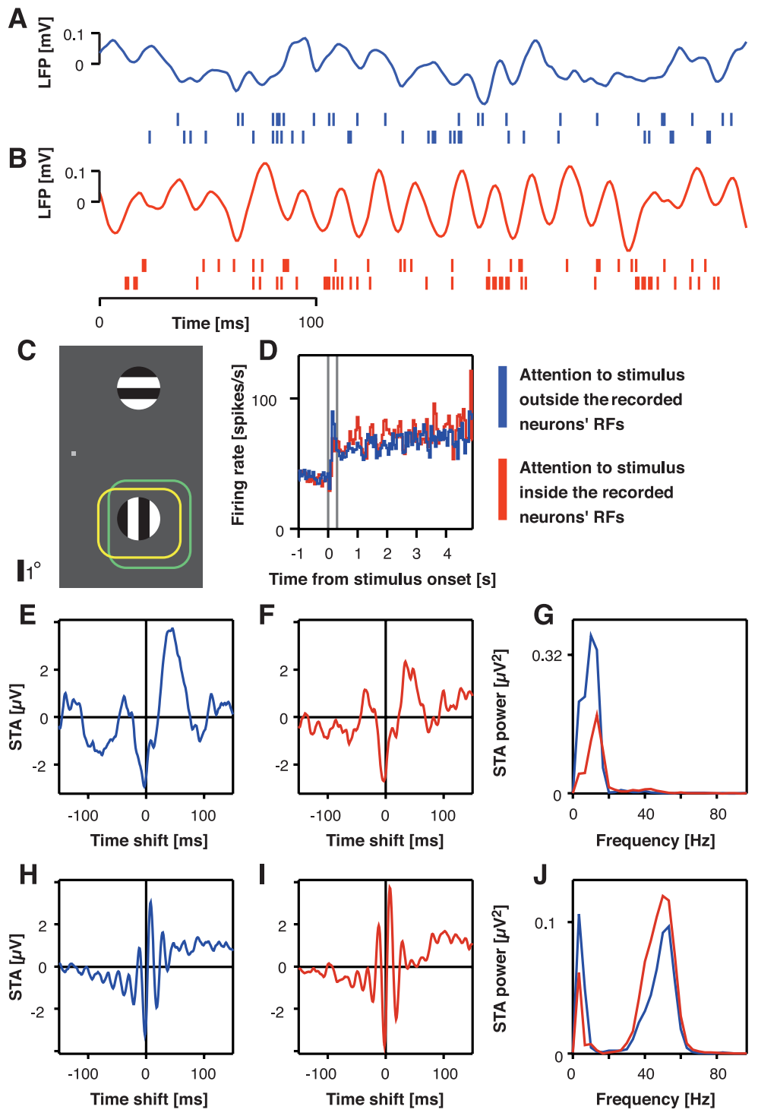
Selective visual attention modulates oscillatory neuronal synchronization
Fries et al (2001) Science
Notes:
Attention: increased in gamma frequency synchronization in V4 neurons but reduced low frequency synchronization.
---
http://science.sciencemag.org/content/291/5508/1560/tab-figures-data
Fig. 1. Attentional modulation of oscillatory synchronization between spikes and LFP from two separate electrodes. Raw stimulus–driven LFP and multi-unit activity with attention outside the RF (A) and into the RF (B). (C) RFs (not visible to monkey; green: spike recording site, yellow: LFP recording site); fixation point and grating stimuli are to scale. The RFs for both recording sites were determined from the multi-unit activity and included only one of the two stimuli. In separate trials, this stimulus was either attended or ignored. Data are from 300 correct trials per attention condition. (D) Firingrate histograms. Vertical lines indicate stimulus onset and 300 ms after stimulus onset. Delay period was the 1-s interval before stimulus onset, and stimulus period was from 300 ms after stimulus onset until one of the stimuli changed its color. Delay-period STAs for attention outside the RF (E) and into the RF (F) and the respective power spectra (G). Stimulus-period STAs for attention outside the RF (H) and into the RF (I) and the respective power spectra (J).

Slide 20
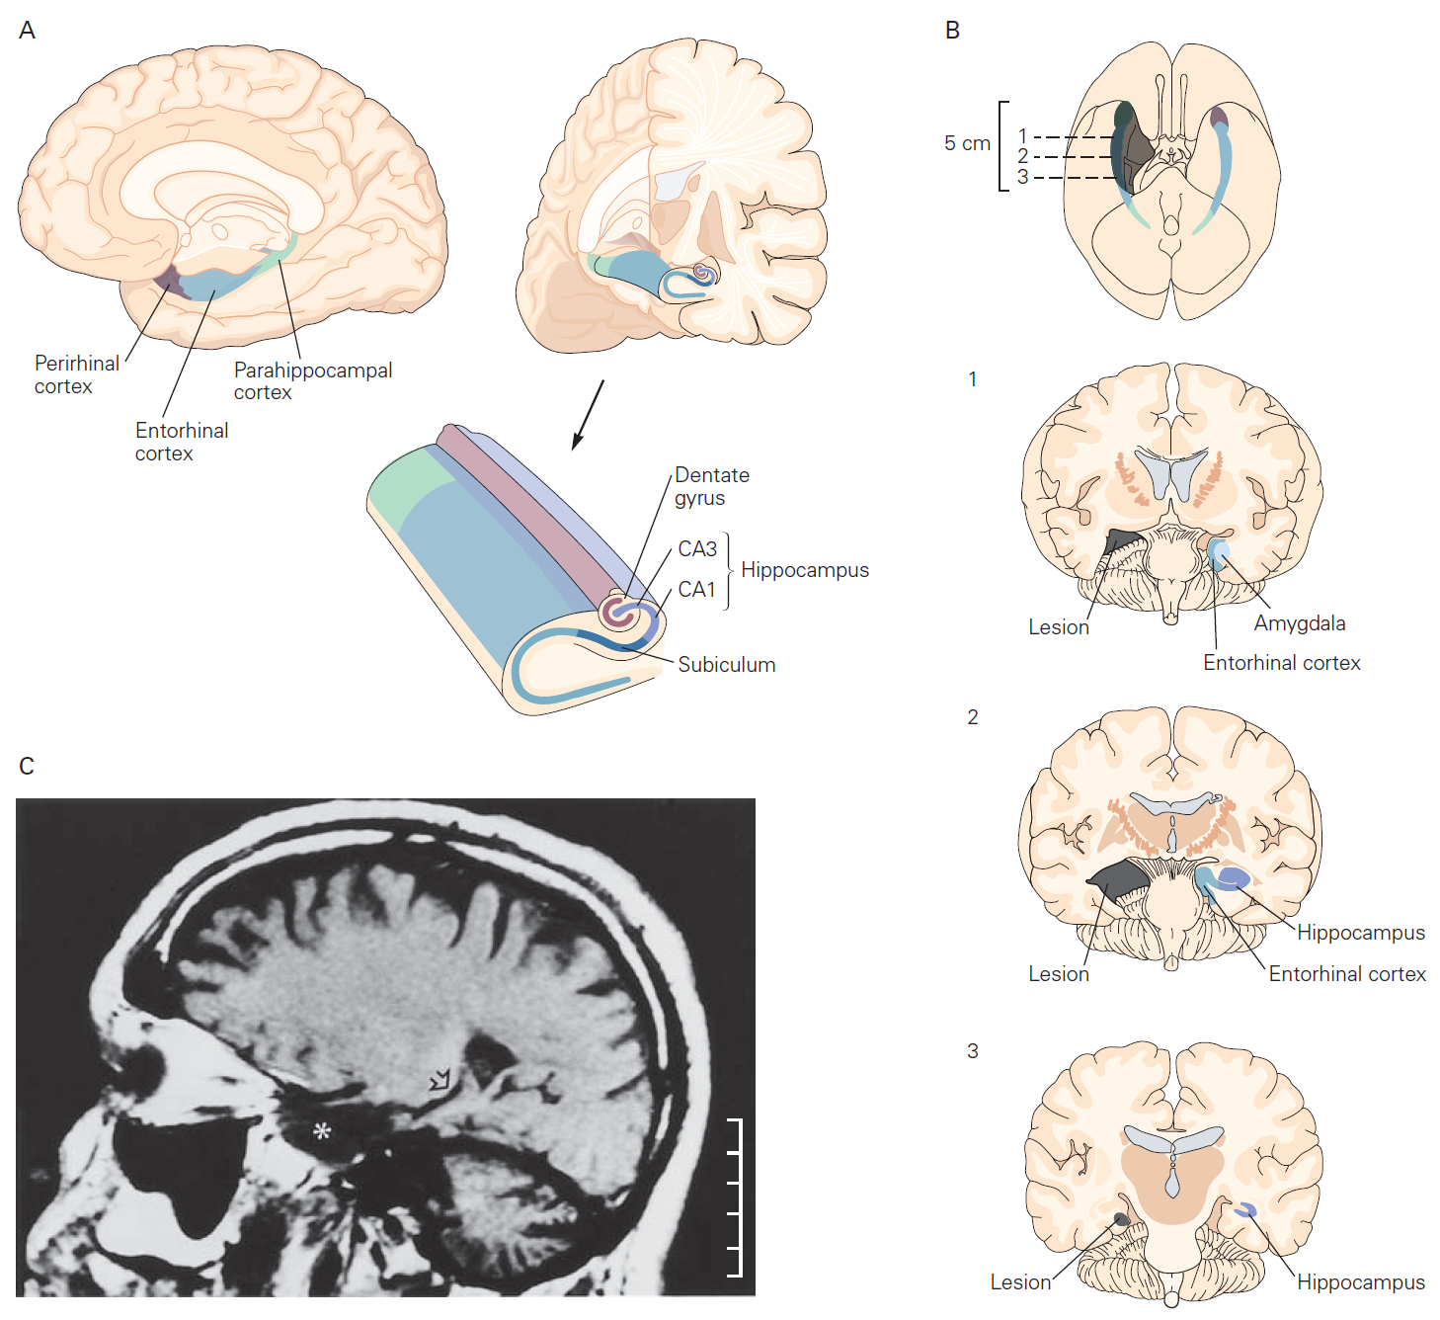
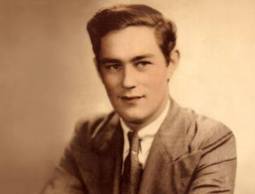
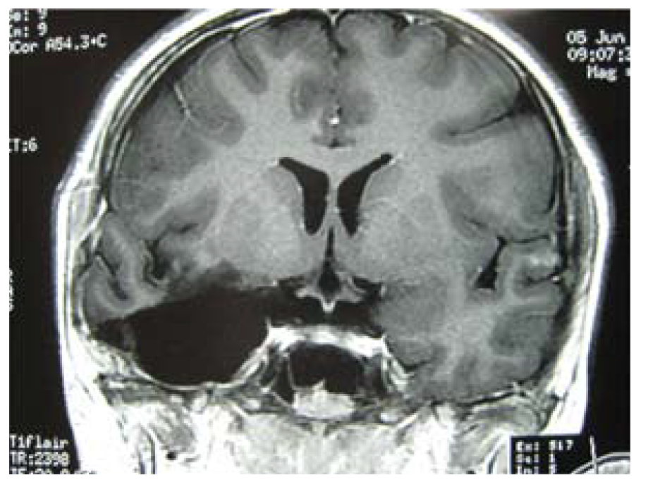
Long-term memory
Henry Molaison (H.M.)
Adapted from Kandel et al. Principles of Neural Science. 5th ed.
Notes:
In the last part of my talk, I would like to talk about learning & memory.
HM -> seizures -> bilateral removal of temporal lobe: amygdalae, entorhinal cortex,
and hippocampi
Result: H.M. knew who he was, remembered his personal history, facts he had learned in school, language, how to do things, social events, people, almost everything—that is, up until a couple of years before his surgery. Besides that, he couldn’t learn new explicit facts.
He had severe anterograde amnesia for explicit memory but he had normal working and procedural memory.

Slide 21
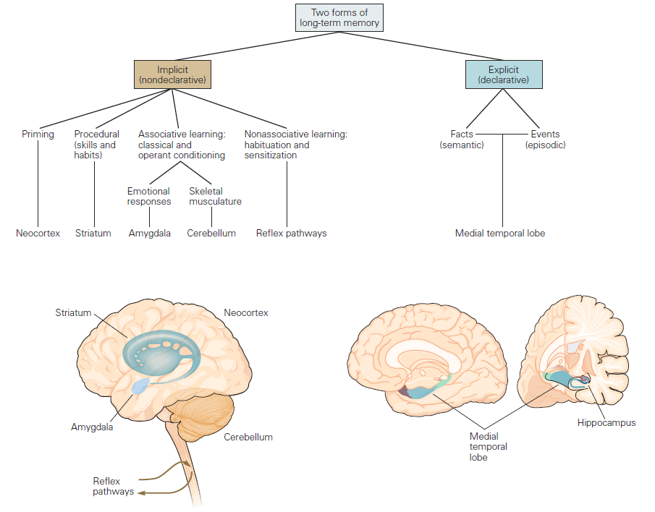
Types of long-term memory
Adapted from Kandel et al. Principles of Neural Science. 5th ed.
Notes:
We have different kinds of long-term memories. We have the explicit memory, which can be roughly described as memory of facts and events which you can verbally described.
And we have the implicit memory, which can be roughly described as the type of memory acquired without you realizing it, such as riding a bike or emotional responses. Of course, different kinds of memories require different configurations of networks.
-----

Slide 22
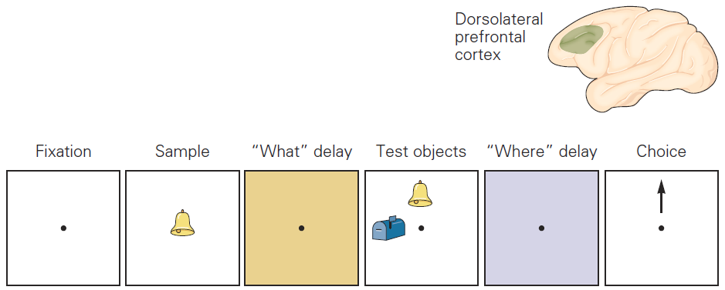
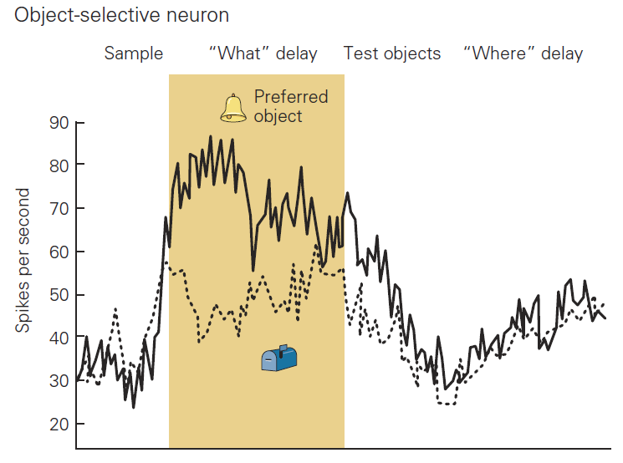
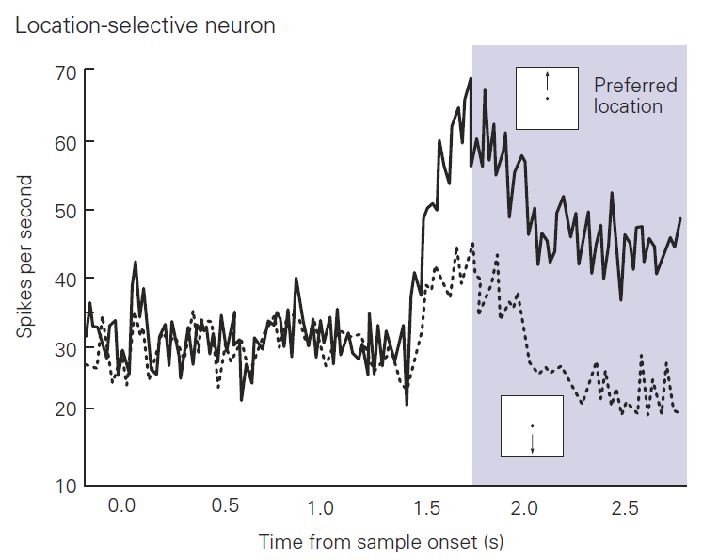
Short-term memory
Adapted from Kandel et al. Principles of Neural Science. 5th ed.
Notes:
Besides that, we have also short-term memory or working memory, which is the memory required for temporarily holding information available for processing.
In this example, if we ask a monkey to perform such a task…
And record from an object-selective neurons and location-selective neurons in the dorsolateral prefrontal cortex, we will see periods of sustained activity while there’s no visual stimulus presented. We can see that the monkey is literally holding the object and the it’s spatial position in memory.
----
Sustained activity
Kandel 40

Slide 23
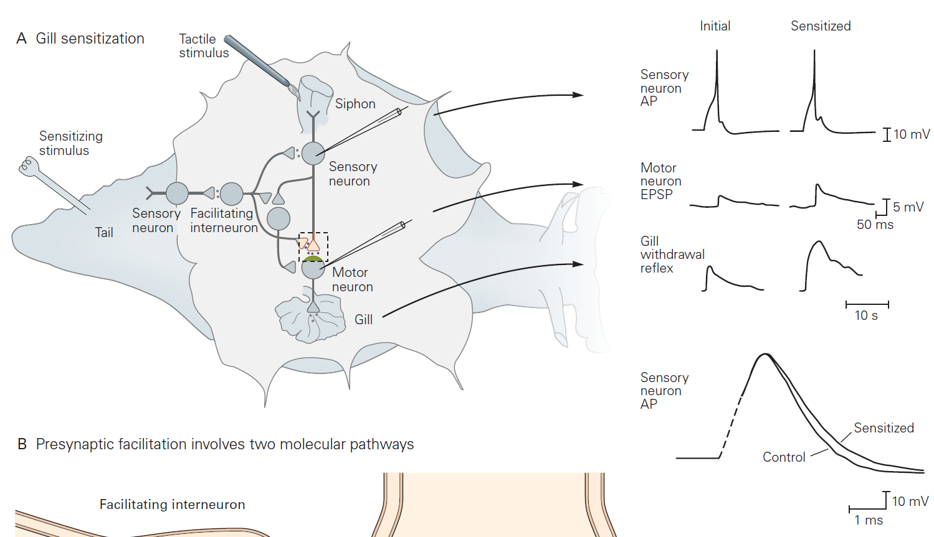
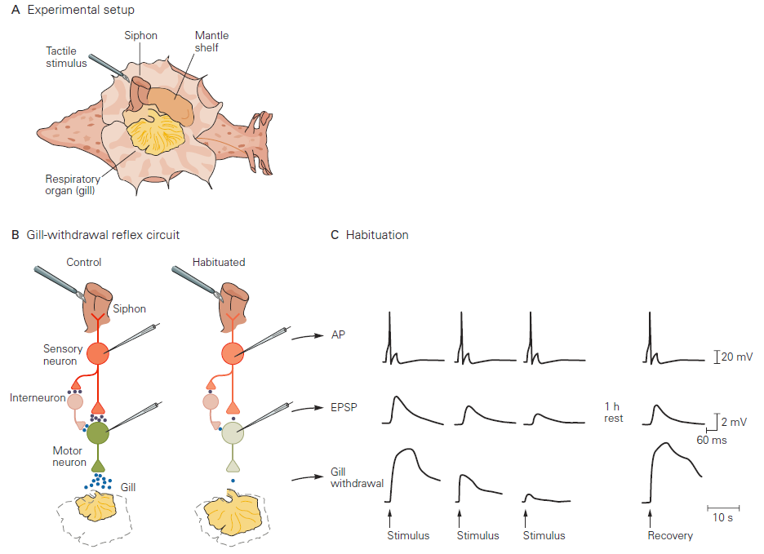
Learning: habituation & sensitization
Sensitization
Habituation
Synaptic depression: depletion of readily releasable vesicles
Synaptic enhancement: increase of readily releasable vesicles
Adapted from Kandel et al. Principles of Neural Science. 5th ed.
Notes:
Kandel 1464, 1466
Touching repeatedly the syphon, there’s habituation. That is, even though the action potential is as strong, there’s a depression of synaptic transmission.

Slide 24
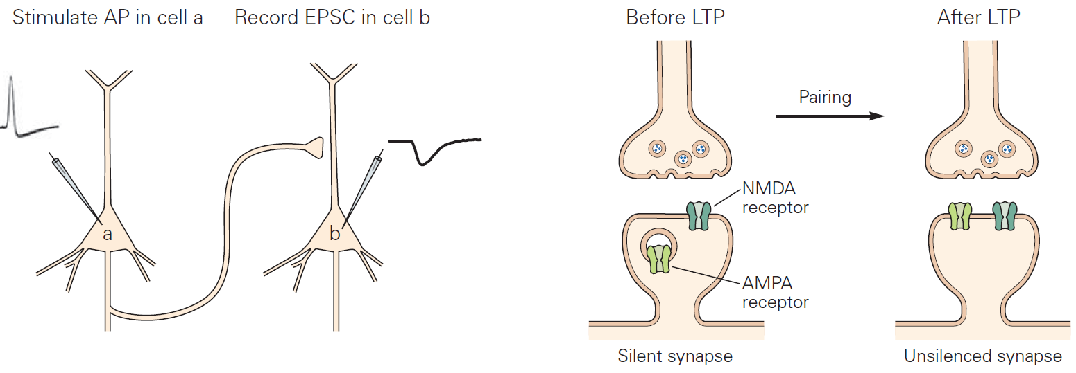
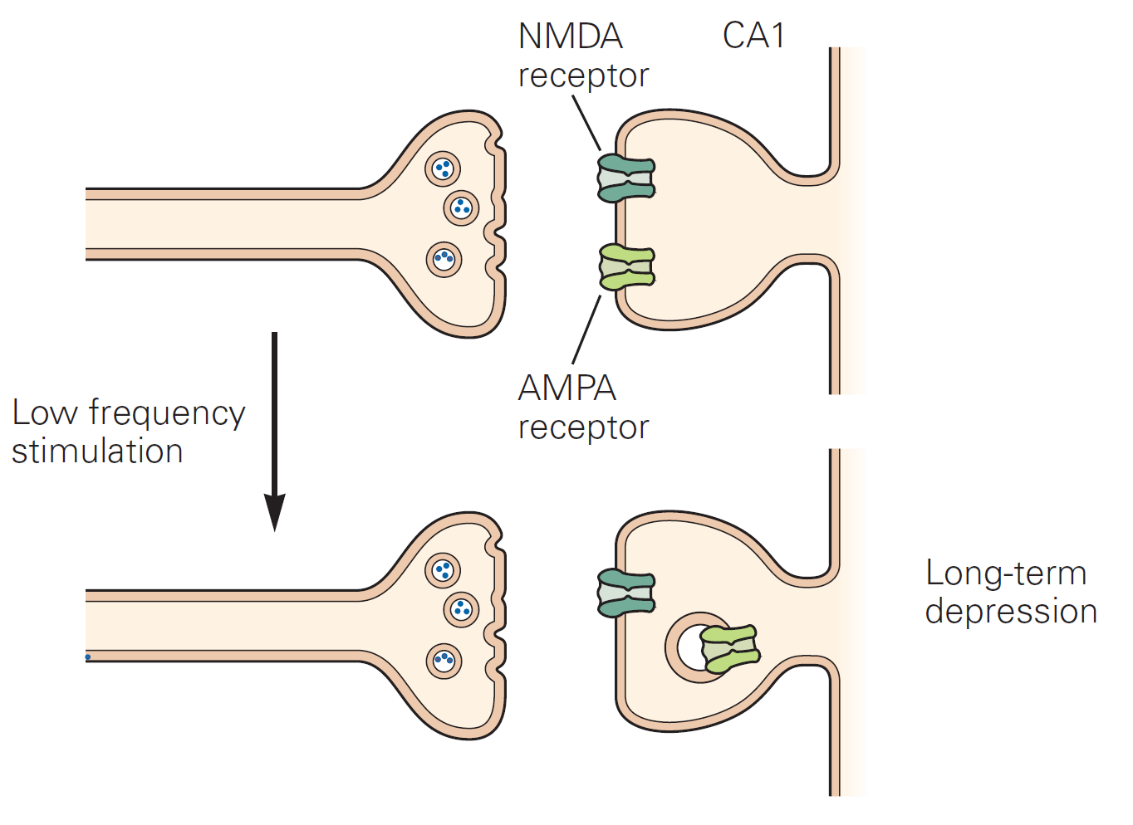
Synaptic plasticity
Short-term plasticity
Synaptic enhancement: increase of readily releasable vesicles
Synaptic depression: depletion of readily releasable vesicles
Long-term plasticity
Long-term potentiation (LTP):
Long-term depression (LTD):
Adapted from Kandel et al. Principles of Neural Science. 5th ed.
Notes:
1496, 1514
Hippocampal neurons

Slide 25
Core cognitive processes
Perception
Action
Attention
Learning & Memory
Language, Emotion, etc …

Slide 26
Thanks!
Brains, Minds & Machines Summer School 2018
Frederico Azevedo
(fazevedo@mit.edu)

